Slide 1
Click here for the
project check in form
Click here for the
Grading Rubric
© 2022 Williams Hands On Science

Slide 8
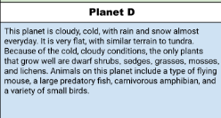
Planet D

Slide 9
Has fur, to stay warm and can fly to high trees and burrow in it
Fish, small amphibians
Flys over lakes, streams and bodys of water that has fish and catched them.
Fly and walks
Two eyes right in the middle
With its wings and claws
Like a bird it goes into the trees and burrows into a nest in the trees.

Slide 10
wings
Helps her fly up into trees to hide from predators
Claws Claws defends her when something is trying to get him
Furry Keeps her warm in the cold

Slide 11
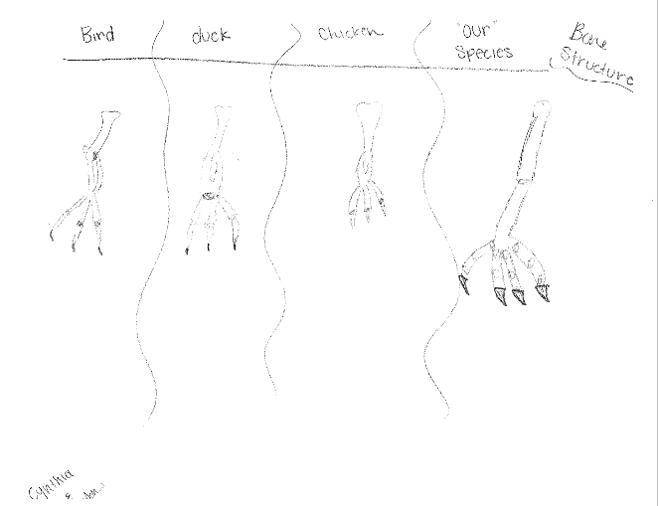
Bird
Duck
Chicken

Slide 12
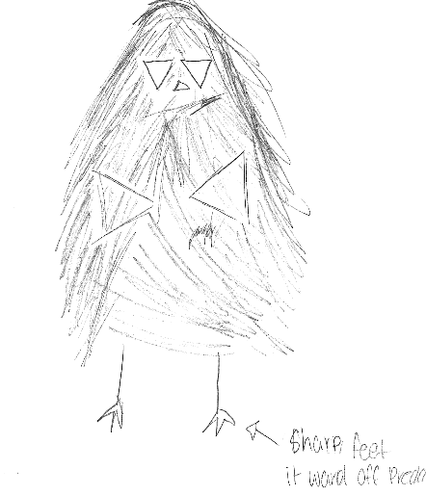
SKETCH OF SPECIES MODEL

Slide 13
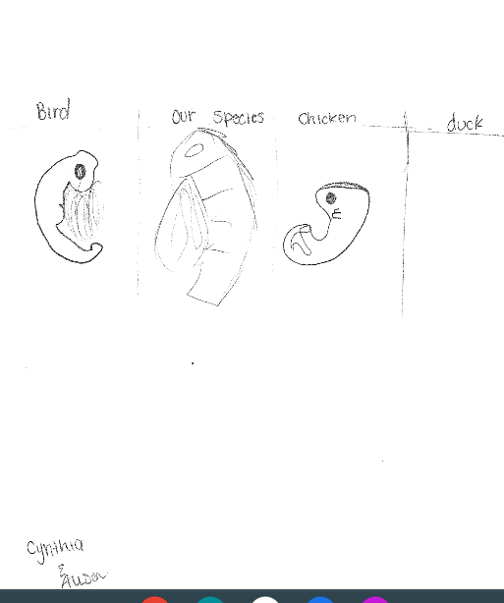

Slide 14
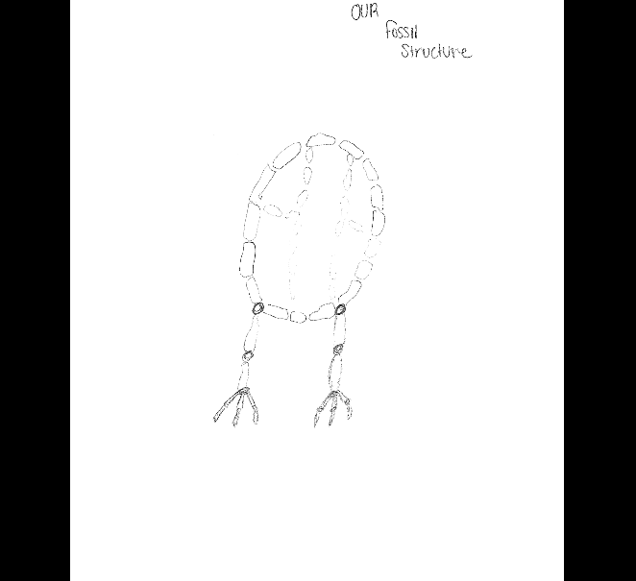

Slide 15
evolutionary descent
embryological development
Natural selection
environmental
Traits
Less

Slide 16
Our species has fur so it doesn’t get cold in its habitat and it has wings and many other features. The wings help it fly high up so it doesn’t get eaten by any predators and the other features is that it has claws. The claws help catch food and defend itself. It has a long beak to drink water from the rivers.

