Slide 1
Click here for the
project check in form
Click here for the
Grading Rubric
© 2022 Williams Hands On Science

Slide 8
B
This planet is similar to a tropical rainforest. It’s mountainous, with large caves in the rainforests. There are large pools, lakes, rivers, and oceans which have warm water in them all year. There are plants that shoot poison when animals come nearby, but have very nutritious flowers. Most of the vegetation include very tall trees, dense shrubs, leaves, fruits, and nuts. Animals include carnivorous flying snakes, varieties of insects, very intelligent omnivorous primates, aquatic organisms, birds, and cave dwelling carnivorous bears.

Slide 9
It can breath underwater and on land because it has gills and lungs
It eats insects and plants and reptiles
It can turn invisible to sneak attack most animals and it can filter salt water
It can fly at super fast speeds
Its eyes are on the head the animal can see thermal
It will pull its wings and head into its shell like body
It makes circle like nests on trees

Slide 10
Shell
The shell is super durable and the poison from the plants has no effect
Long beak
The long beak help the animal cach insects from a distance
Gills
The animal has lungs and gills for underwater and on land

Slide 11
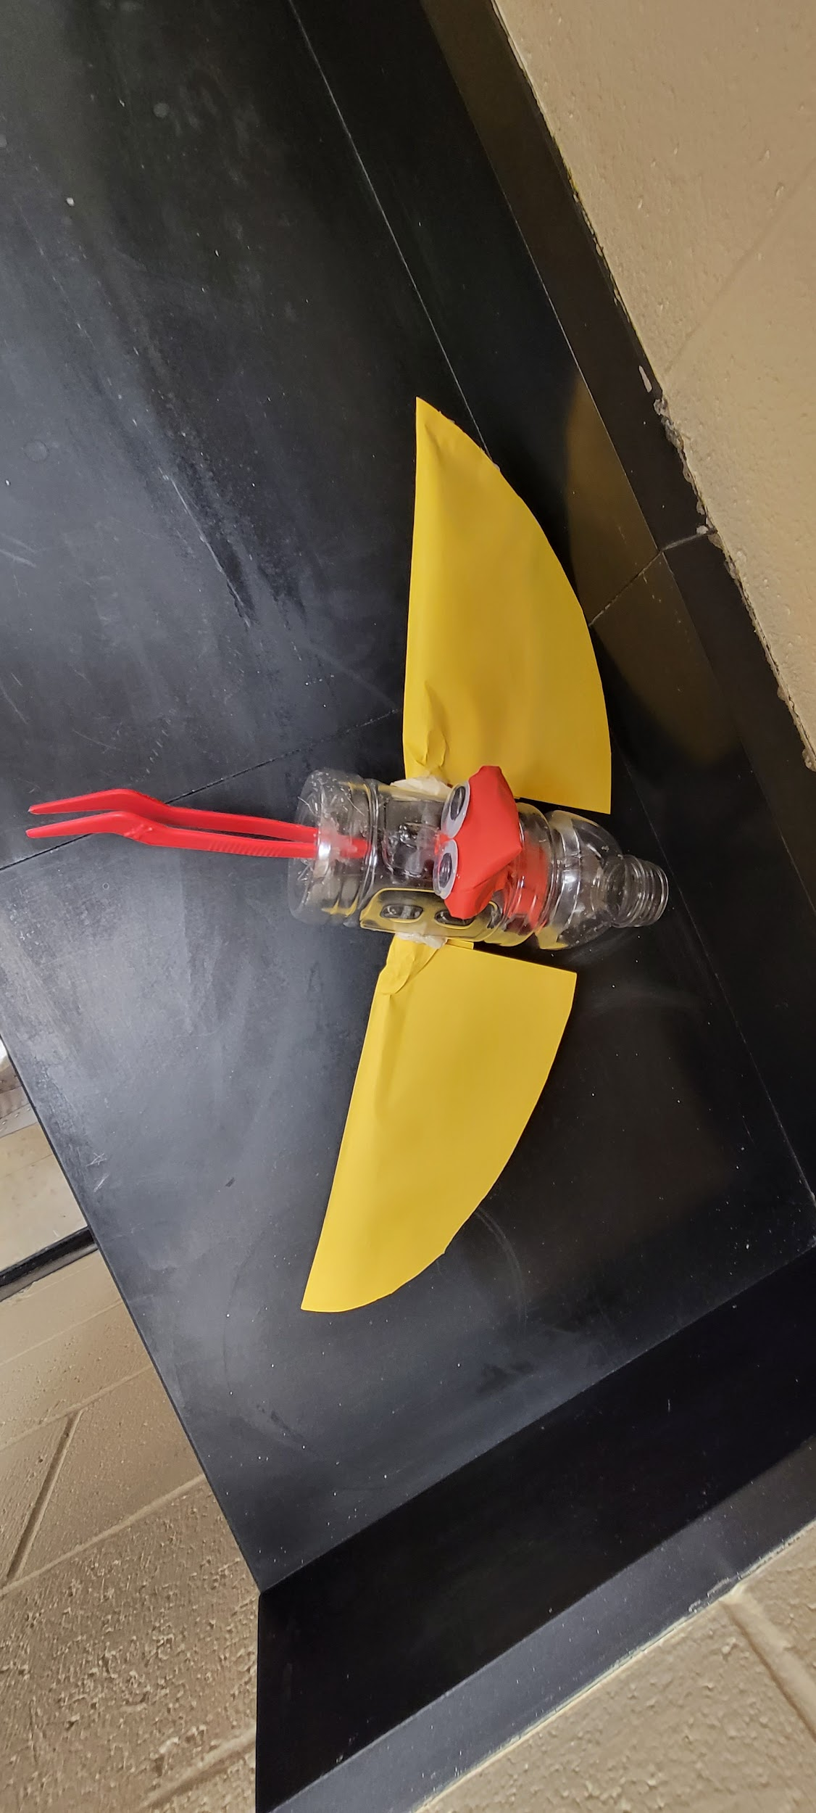
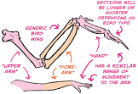
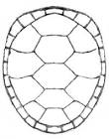
bird
Hummingbird
Turtle
Quietbird

