Slide 1
Click here for the
project check in form
Click here for the
Grading Rubric
© 2022 Williams Hands On Science

Slide 8
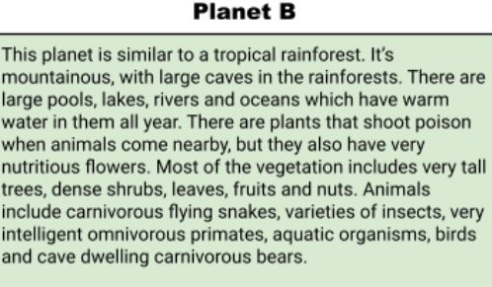
Planet b

Slide 11
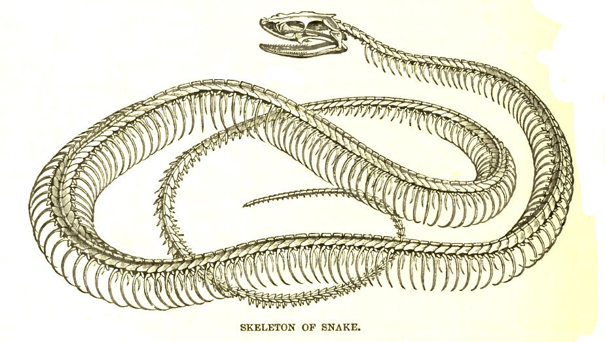
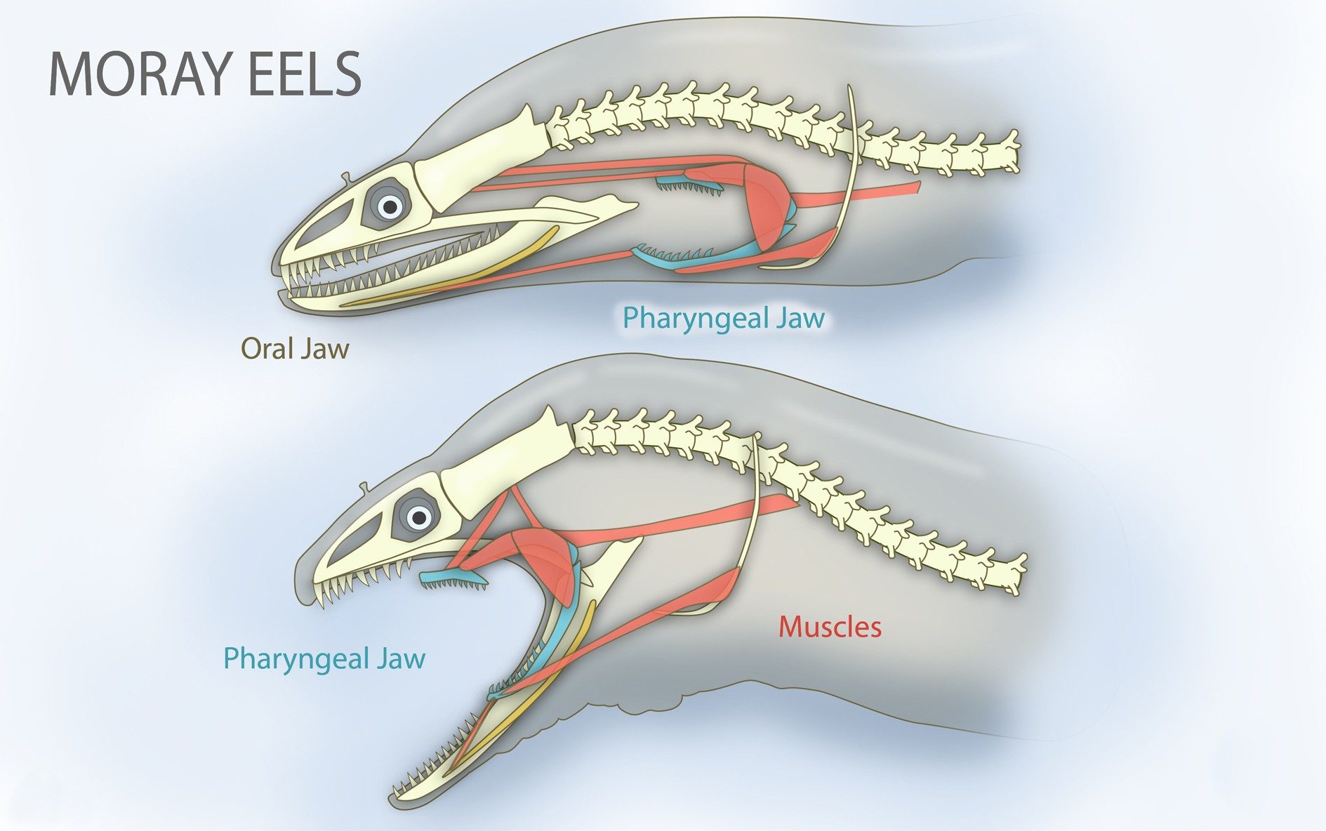
Homologous structures are evidence of common ancestors.

Slide 12
SKETCH OF SPECIES MODEL

Slide 13
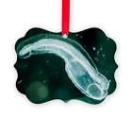
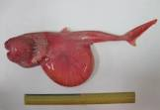

Slide 15
evolutionary descent
Traits
Natural selection
embryological development
environmental
Less

Slide 16
My species is able to survive and thrive due to its traits because it is pretty big to make it look intimidating to predators. It is fast and strong so it can fight or flee from any situation. It is also very creative with it’s habits because it builds them out of vegetation to help it hide in plain sight. It has also made the adaption to realise which plants are poisonous and which ones are safe to eat and be around. It has also highly memorised its environment and the surrounding creatures so it knows what to avoid. It has a very similar homologous structure to the standard snake however it has a sticky back for carrying things and it has grippers on its stomach to help it climb. It is very difficult to study its embryology due to the constant changing of traits therefore natural selection will be a non factor for years to come.

