Slide 1
Click here for the
project check in form
Click here for the
Grading Rubric
© 2022 Williams Hands On Science

Slide 8
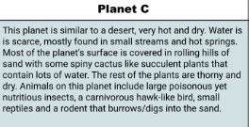

Slide 9
It is going to bariy its self in the sand so that it si not getting hotter from the sun
creatures in the sand and some plants
They are going to dig down and hunt the other creatures in the sand, they will uses the catises for water
It walks or digs
It is going to have eyes on the side of its head so that its harder for it to get sand and other things in its eyes while also making it so that they can see there surroundings better
When it sees a hawk it is going to dig down or it will use its sharp spines to stop it from garbing them
They will make little holes in the ground that lead to its den, to make it hard for other things to get into its den it will build a maze

Slide 10
Spines on the back
This spikey back will help to find off some of the predators and make it easier to open plants for water
Eyes on the side of there head
It will make it so that they can see around them better and stop the sand form going in there eyes
Sharp claws
It makes it so that they can dig better and faster. While making it earlier to get their prey

Slide 12
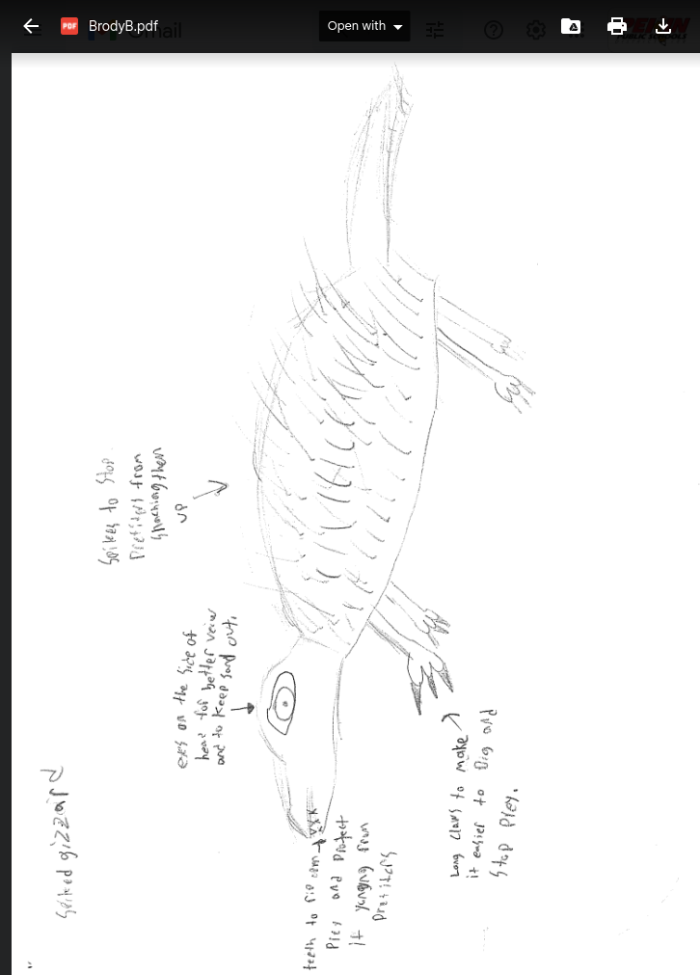
SKETCH OF SPECIES MODEL

Slide 13
snake
fish
geco

Slide 14
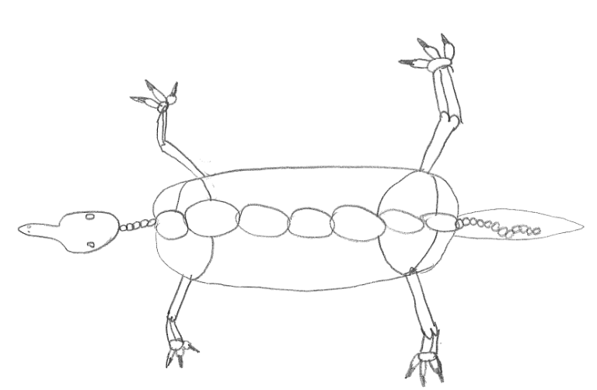

Slide 15
evolutionary descent
embryological development
Natural selection
environmental
Traits
Less

Slide 16
The spiked gizzard would be able to survive on the hot dry and sandy habitat. Throughout time my species would go under natural selection that would leave the best suited version alive. While they are under natural selection they would start having adaptations that would cause them to be better than what they started as. But to start with there spikes would help them to stay protected along with their sharp claws for digging and kills prey, with these traits they are set up to have a good start. The embryology is similar to a snakes and to other reptiles that do survive in the deserts, so that gives them a better chance of survival than having the embryology of other animals. There homologous structure in their legs similar to there animals that are good at running. So they would be able to run similar to the other small animals that are fast in their environment. My animal the spiked gizzard is more than capable to survive with it’s traits on that sandy world.

Slide 17
