Slide 1
Click here for the
project check in form
Click here for the
Grading Rubric
© 2022 Williams Hands On Science

Slide 8
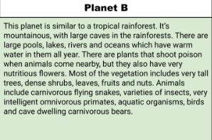
Planet B

Slide 9
Want to be cold go in water or grass, warm leigh in sand
Flowers, insects, fruits and nuts
Their tail will catch the food and there skin will absorb the water
Walk and swim
Eyes in the front over the nose, short body, long arm/legs and tail, gills on the sides of their bodys.
Burrows in the sand, changes color and hides in water.
Gives birth in the sand and hides the babies in it till they develop more.

Slide 10
Long arms/legs
Gets around faster and easier.
Long tails
Helps get food easier.
Short body
Helps it hide in smaller spaces.

Slide 11
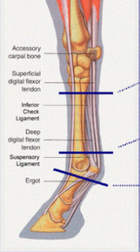
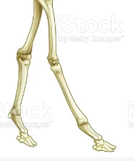
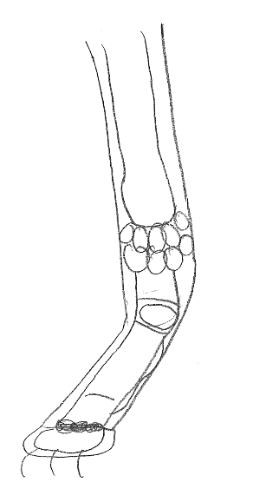
Horse
Giraffe
Gazelle
Fizouris

Slide 12
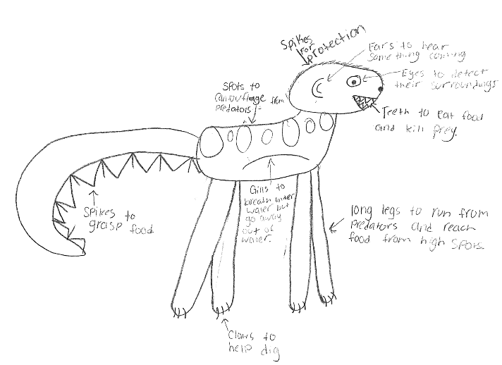
SKETCH OF SPECIES MODEL
Fizouris

Slide 13
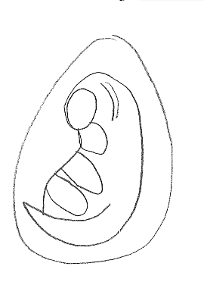
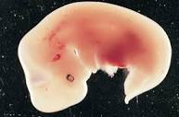
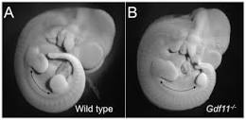
Horse
Giraffe
Gazelle
Fizouris

Slide 14
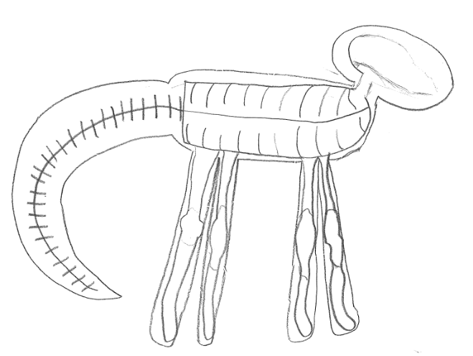

Slide 15
evolutionary descent
embryological development
Natural selection
environmental
Traits
Less

Slide 16
The Fizouris is a mammal that lives in Planet B. It has a tail with spikes to get its food/prey. It has long legs to move fast, gills for in the water but go away when out of water. It’s embryo is most similar to a gazelle. It’s short body to hide better. It’s leg bone structure is most similar to a horse.

