Slide 1
Teachers:
I use these slides to help the students with directions, modeling, lesson pacing and classroom management.
Click here for Student Research Pages hard copy
Click here for Student Directions hard copy
Click here for students directions
Click here for the
project check in form
Click here for Student Research Pages
Click here for the
Grading Rubric
© 2022 Williams Hands On Science

Slide 2
Teachers:
Here I give students ideas for bringing materials the next class meeting. I provide glue, scissors tape and paper. They are responsible to bring in everything else. I suggest to them that they grab stuff from around the house and to not purchase materials if they don’t have to.

Slide 4
Teachers:
I don’t read about each habitat aloud, they can read that when they look at the directions.
Teachers:
However, I read the description of one of the planets and explain to them that they should continuously refer to the planet description they chose. Because they are basing the design and all of the traits and adaptations on that habitat.

Slide 5
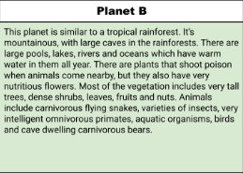
Teachers:
Here I talk about each slide of the students research pages, show the examples and what is expected of them.
Planet B
Teachers:
I allow students to get creative and add more organisms to the planet they chose.

Slide 6
Water, weather
Nutrients in the soil, water
The ground or local stream
Walks
In the center of it head / middle of the flower
Blending in with surroundings
By the stream next to a tree lies its home, there beds will be made of soil

Slide 7
Poisonous pedals fights of predators shoots its pedals
Tail the tail wacks things
Feet helps it get places and run from predetors

Slide 8
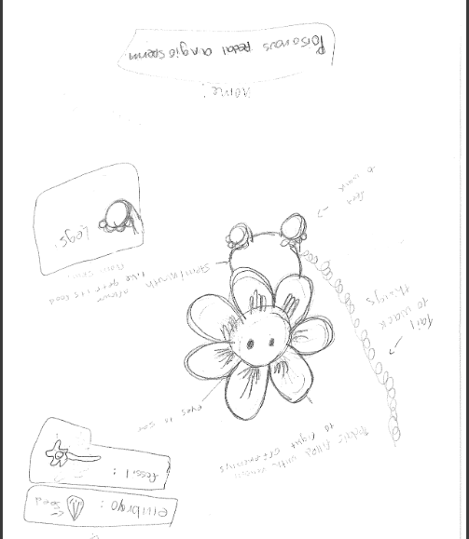

Slide 11
evolutionary descent
embryological development
Natural selection
environmental
Traits
Less

Slide 13
Our species is able to survive by its petals are poisonous and can use its tail to wack things,it thrives by the stream and the soil

