Slide 1
Click here for the
project check in form
Click here for the
Grading Rubric
© 2022 Williams Hands On Science

Slide 8
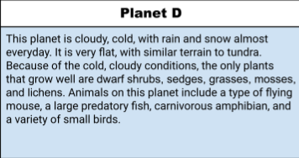
Planet D

Slide 9
It has long fur
It eats small birds and mosses
It has claws and a long tongue
It walks and flies
It has four eyes to help it see during blizzards
It will have white fur to blend into the snow
It has a pocket to carry its young in and it find shelter by making burrows

Slide 10
Claws
The claws it chetch the small bird it eats
Fur
The fur helps it stay warm and helps it blend in
Wings
The wings help it fly to catch flying birds and escape predators

Slide 11
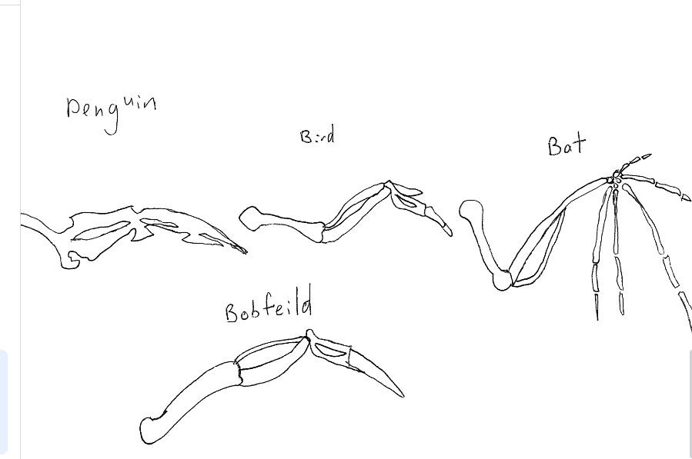
Bat
Bird
Penguin
Bobfeild

Slide 12
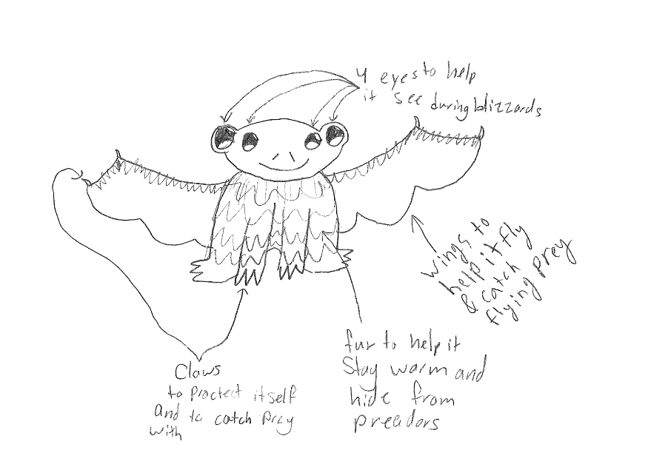
SKETCH OF SPECIES MODEL

Slide 13
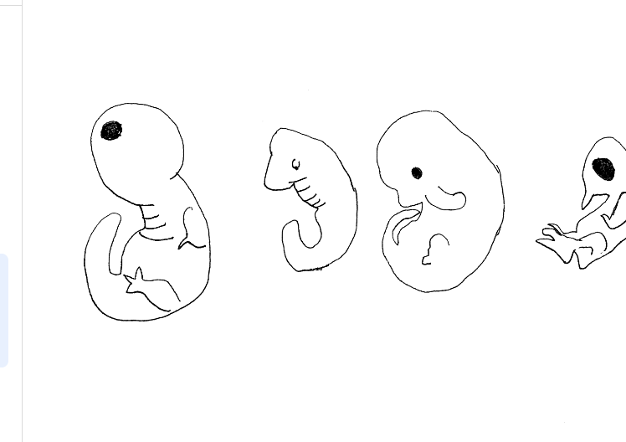
Eyes
Eyes
Eyes
Eyes
Bird
Mouse
Fish
Bobfild

Slide 14
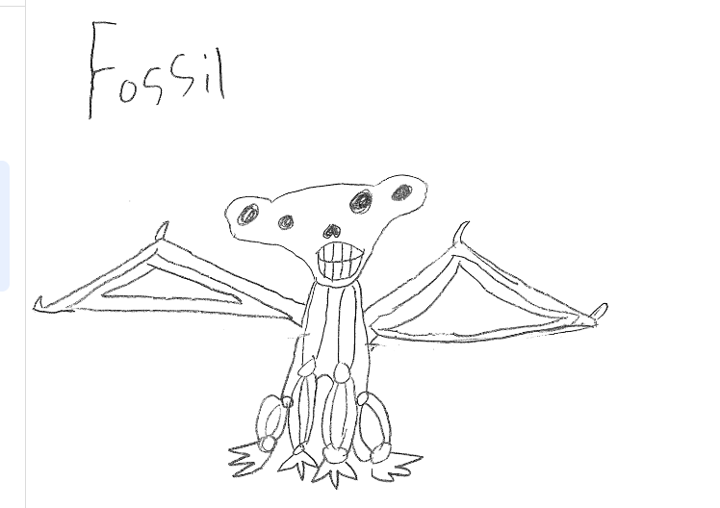

Slide 15
embryological development
evolutionary descent
Natural selection
environmental
Traits
Less

