Slide 1
Teachers:
I use these slides to help the students with directions, modeling, lesson pacing and classroom management.
Click here for Student Research Pages hard copy
Click here for Student Directions hard copy
Click here for students directions
Click here for the
project check in form
Click here for Student Research Pages
Click here for the
Grading Rubric
© 2022 Williams Hands On Science

Slide 3
Teachers:
I discuss each of the following slides to the students.

Slide 4
Teachers:
Here I give students ideas for bringing materials the next class meeting. I provide glue, scissors tape and paper. They are responsible to bring in everything else. I suggest to them that they grab stuff from around the house and to not purchase materials if they don’t have to.

Slide 6
Teachers:
I don’t read about each habitat aloud, they can read that when they look at the directions.
Teachers:
However, I read the description of one of the planets and explain to them that they should continuously refer to the planet description they chose. Because they are basing the design and all of the traits and adaptations on that habitat.

Slide 7
Teachers:
Here I emphasize what they need to think about when making their model/sketch and the final model they build.

Slide 8
Teachers:
Here I emphasize what they need to think about when filling out the student research pages.

Slide 9
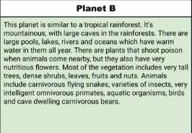
Teachers:
Here I talk about each slide of the students research pages, show the examples and what is expected of them.
Teachers:
I allow students to get creative and add more organisms to the planet they chose.

Slide 10
Warm
Leaves fruits and nuts
Water- from large pools lakes and rivers food- food from the environment
Its flys and walks
The eyes are on the side of the head so it can see forward and backward.
Hiding in the caves or dead tree stumps
They will live in the mountains with big trees and feed their young leaves fruits and nuts

Slide 11
Wings escape from predators
Eyes on the side of the head to see forward backward and sideways
Green and brown color so it can camouflage in the tree

Slide 12
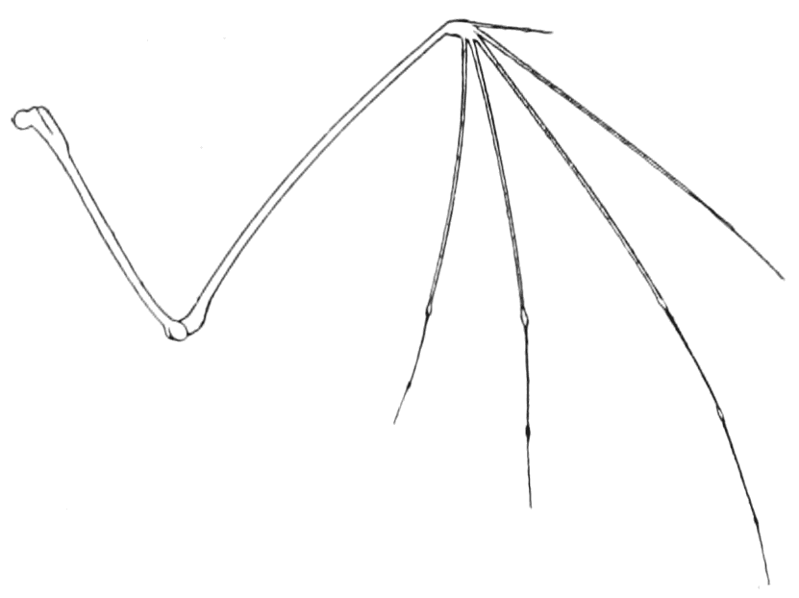
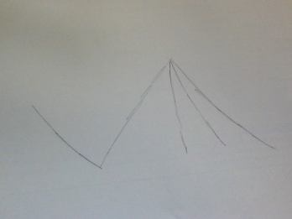
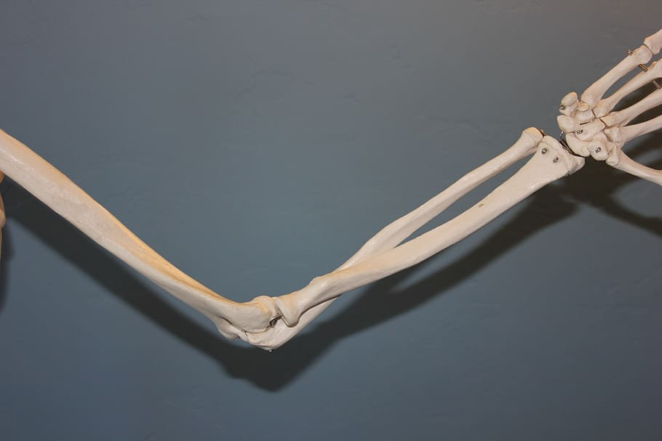
Arm and hand structure
Bat
humans
The Big mouth woody
bird

Slide 13
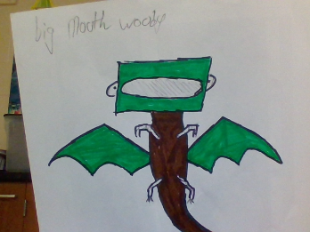
SKETCH OF SPECIES MODEL

Slide 14
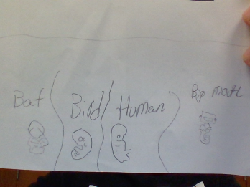

Slide 15
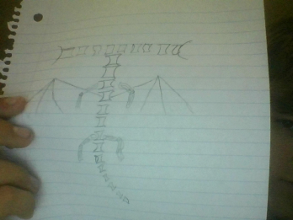

Slide 16
evolutionary descent
embryological development
Natural selection
environmental
Traits
Less

Slide 17
The big mouth woody is a creature that has adapted to its environment and blends to the trees and logs with its beautiful green and brown colors. The big mouth woody is a very fascinating creature its head is shaped like a rectangle and the eyeballs are on the side of its head so it can see other predators sneaking behind them in front of them and even on the side of them. That's not all this creature has, it has wings to fly in the caves and above the trees so it can look for food and predators.
The big mouth woody uses dead logs on the ground to hide and have the babys from all the creature that hunt them. Over all this creature is a very fascinating creature, with all of its colors, wings, head shape, and its legs.

Slide 18
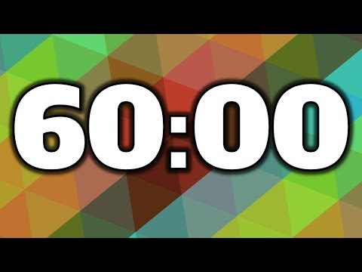
Teachers:
I now give students 60 minutes to work on part 1.
Groups of
1, 2 or 3
We will build next class meeting
Teachers:
I let them work alone or in groups of 2-3.
Discuss with each other and gather materials at home before the next class meeting.
Open Student Research Pages and Directions
Teachers:
After 60 minutes, or with about 30 minutes in class left, have them do the project check in form
Get Started
© 2022 Williams Hands On Science

Slide 19
Teachers:
This helps them stay on track and pay attention to the requirements.
Teachers:
I allow them to do this together in groups and then make adjustments and/or additions to part 1.

Slide 20
Teachers:
This completes the first day, which for my 8th grade students is a 1 hour and 50 minute period.
I dedicate day two entirely to building, which again, is a 1 hour and 50 minute period.

Slide 21
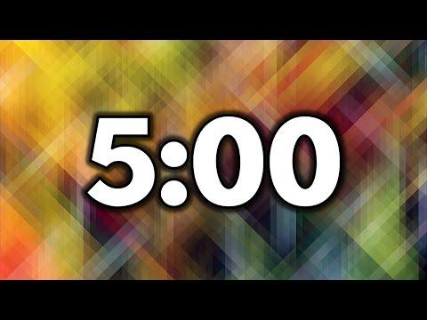
Teachers:
I give students 5 minutes to sort out who will present and what they will say. I allow them to read right off of the slide if they want.
Get together with your group members and discuss the following:
Who will present the model to the class?
Discuss what the name of your new species is.
Open this slide from Part 1
Discuss the 3 physical traits you came up with for your new species.
The presenter will tell the class the 3 main adaptations/physical traits your organism has, what planet it lives on and how it uses those traits to survive on the planet you chose
Teachers:
Each group presentation takes 1-2 minutes depending on how many questions students ask questions.
© 2022 Williams Hands On Science

