Slide 1
Click here for the
project check in form
Click here for the
Grading Rubric
© 2022 Williams Hands On Science

Slide 8
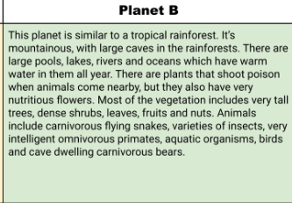
Teachers:
Here I talk about each slide of the students research pages, show the examples and what is expected of them.
Planet B
Teachers:
I allow students to get creative and add more organisms to the planet they chose.

Slide 9
Hair,Fur
Bugs,Fruits,Plants
Hunting,Scavenging,and stealing
Walk,Swings
Eyes next to the nose
Staying in trees,using its claws for defense
Its shelter is in the trees and they live in packs so multiple can leave and then the rest can stay and watch the young.

Slide 10
Climb trees,Protection,cutting up food
Claws
Tail with long spike at end
Helps swing from trees and helps defend from predators
Turtle shell like skin
Protection from predators.

Slide 11
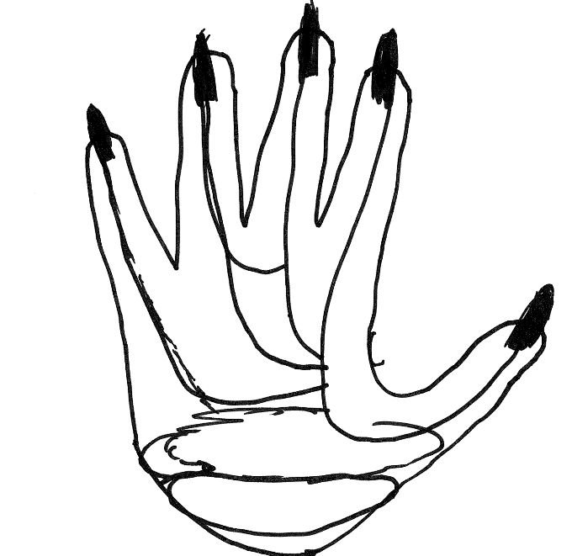
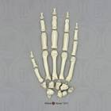
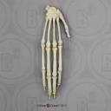
Chimp
Ape
Spider monkey
ClawusPrimatus

Slide 12
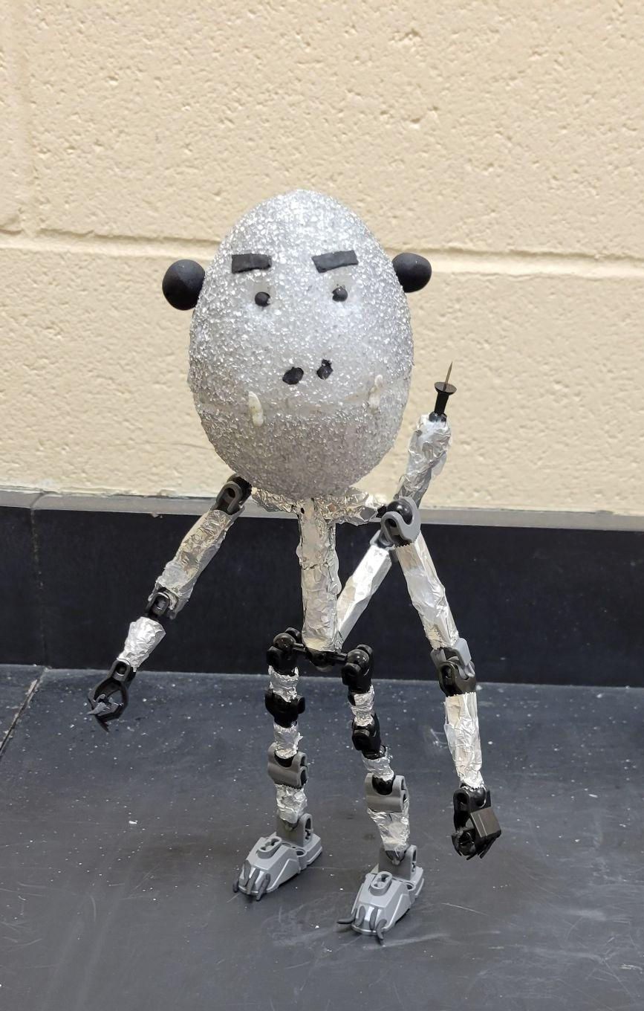
SKETCH OF SPECIES MODEL

Slide 13
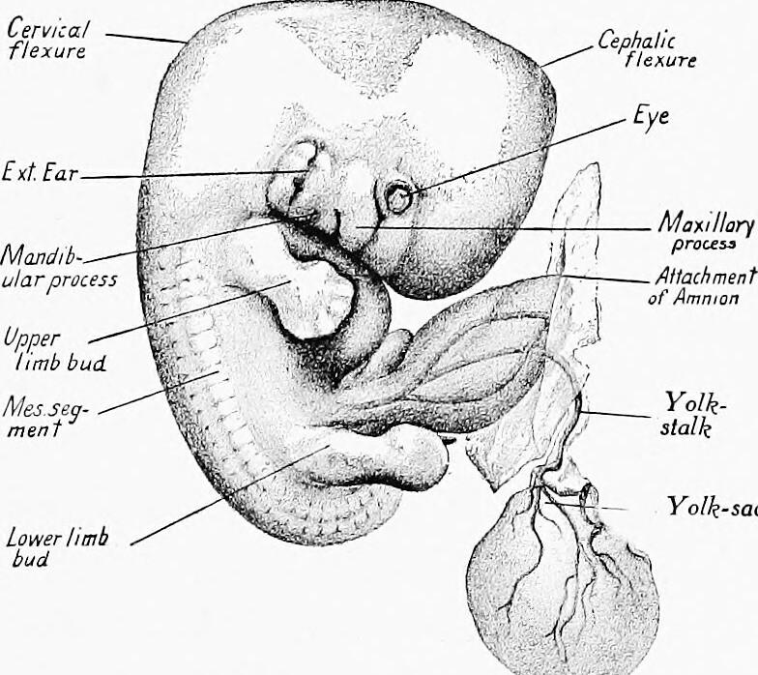
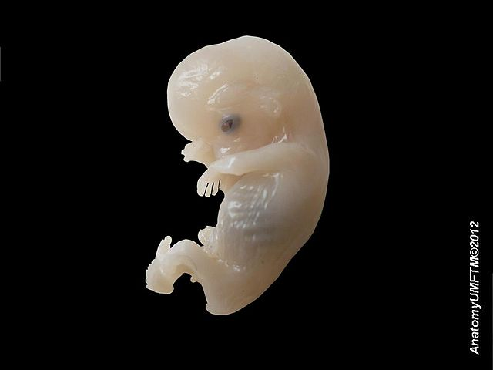
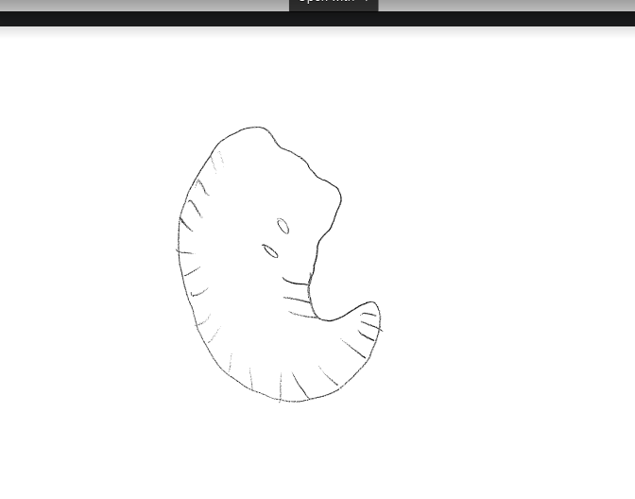
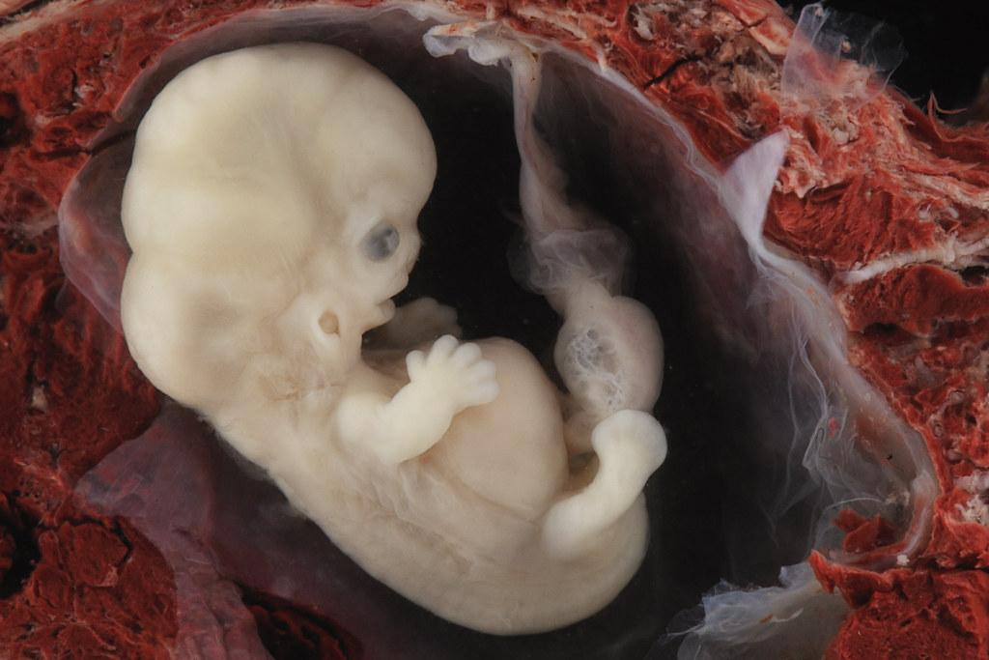
pig
human
Dog
ClawusPrimatus

Slide 14
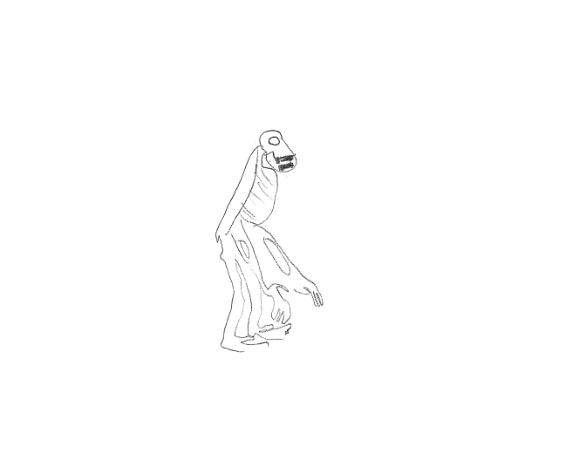

Slide 15
Natural selection
embryological development
evolutionary descent
environmental
Traits
Less

Slide 16
The clawusPrimatus would be able to survive because it has claws for getting food and climbing trees and its tail helps it climb trees and defend itself from predators.

