Slide 1
Click here for the
project check in form
Click here for the
Grading Rubric
© 2022 Williams Hands On Science

Slide 8
Planet D

Slide 9
Slick water repellent fur
Shrubs
It will find shrubs and drink water from the habitat of the predatory fish
Walk & Swim
Sides of the heads
By camouflaging to the snowy environment and swimming away from the fish
Make burrows in the ground near the water and shrub area

Slide 10
White fur
Blending in with the snowy surrounding
Webbed feet
For swimming in the water
Round teeth
For eating plants and shrubs

Slide 11
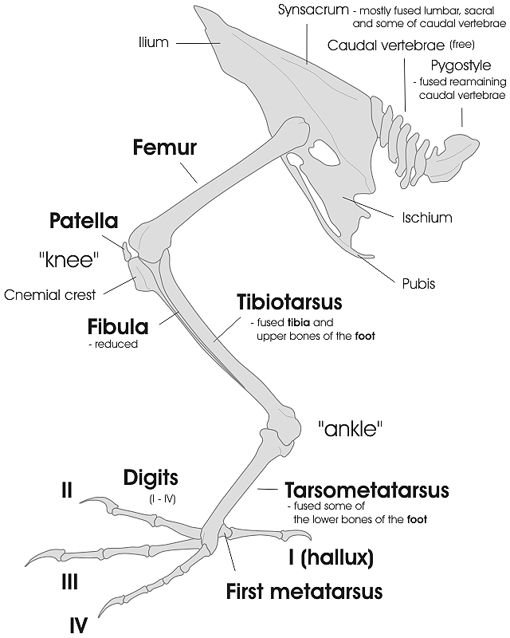
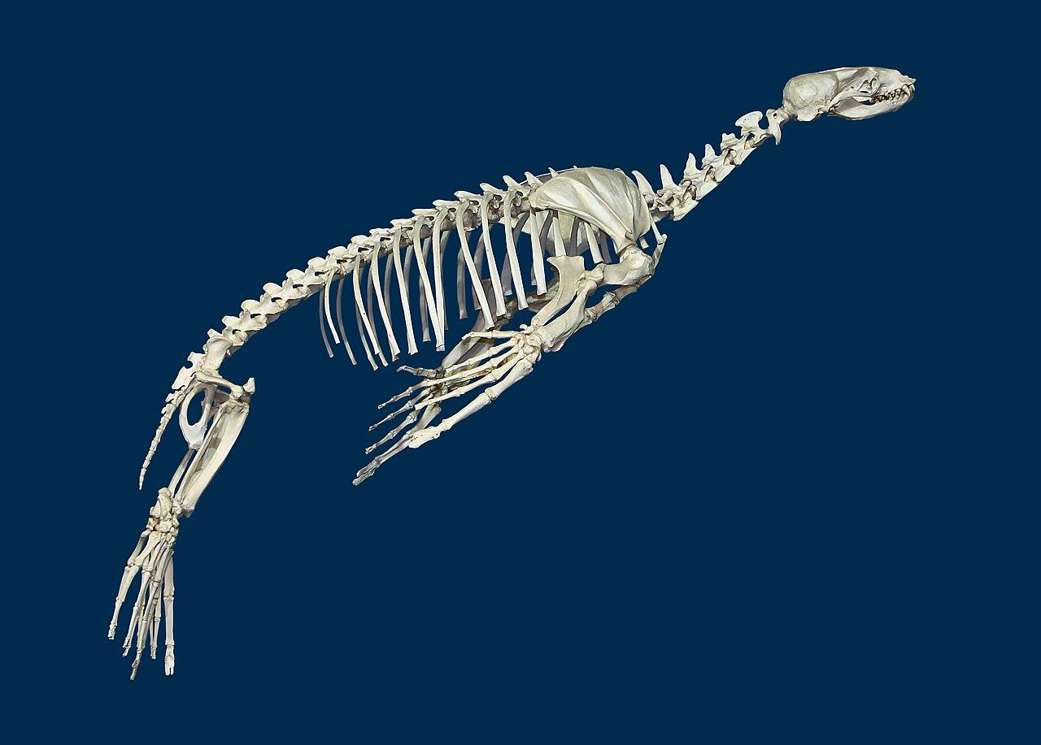
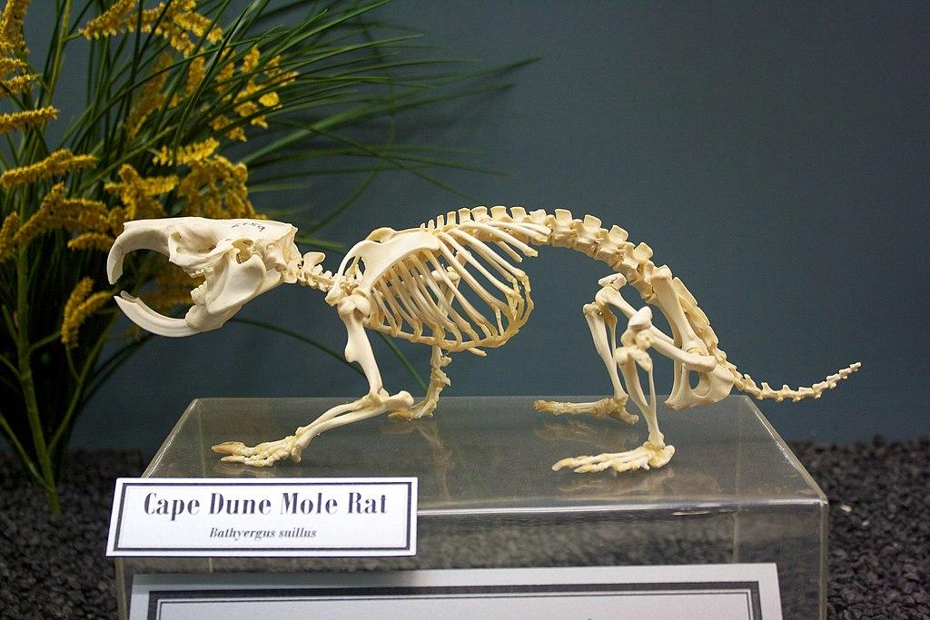

Slide 12
SKETCH OF SPECIES MODEL

Slide 13
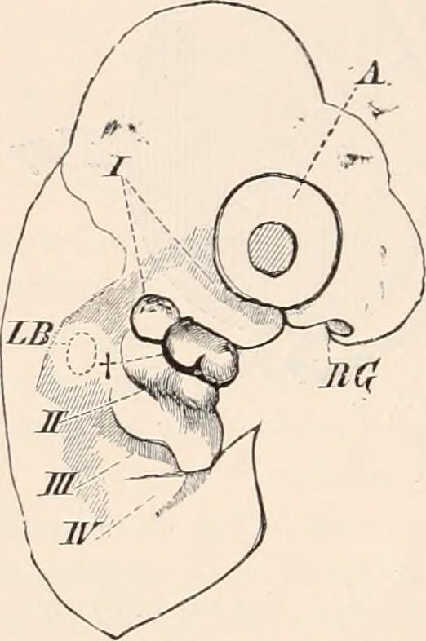
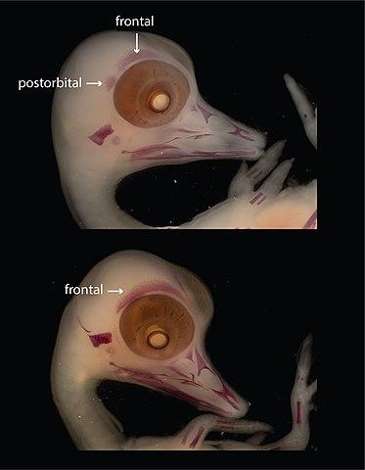
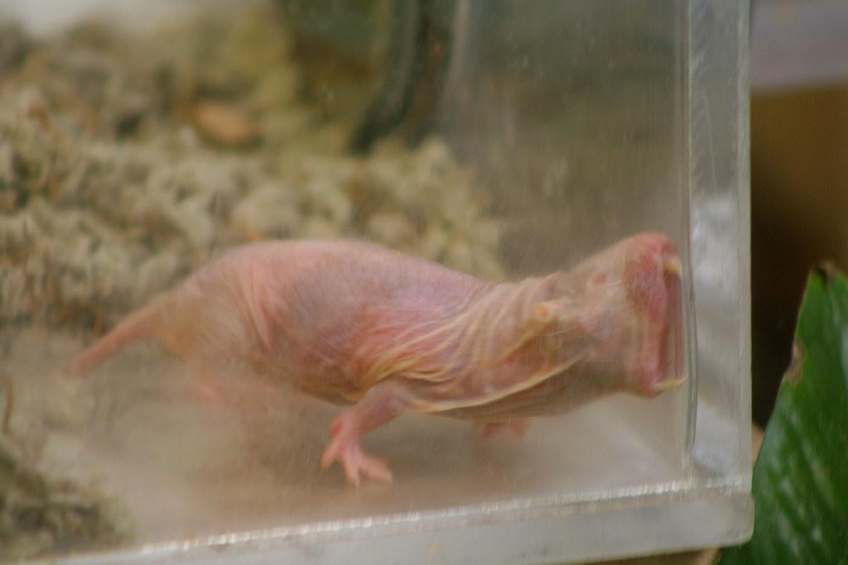
Duck
Otter
Mole rat

Slide 15
evolutionary descent
embryological development
Natural selection
environmental
Traits
Less

Slide 16
My Alien has used adaptation to slowly but surely blend into its environment by using it’s white fur. Originally my Alien had brown fur but overtime and due to natural selection my alien has become fully white just like the snowy white landscape around it. Also my alien has long square front teeth for Digging and for eating the local shrubbery.

Slide 17
