Slide 1
Click here for the
project check in form
Click here for the
Grading Rubric
© 2022 Williams Hands On Science

Slide 8
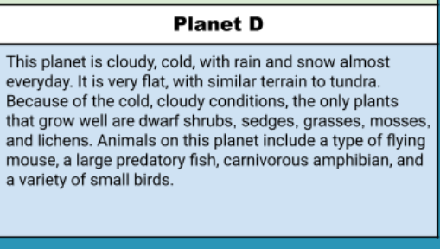
Planet D

Slide 9
it will stay warm by its big thick coat of fur
It will eat fish and the flying mouse
It will catch the fish by spotting it in the water, then it will swoop down and catch it with its claws on its feet. It will catch the flying mouse by just eating it out of the air.
It can fly, swim, and walk anywhere it wants to.
It is colorblind and can only see the colors black, white, grey, and gold. The eyes position is like a humans, it faces straight.
It will fly away at 150mph and swims at 62mph but it only knows how to walk. It uses its spiky tail and back and feet to attack and scare the predators.
It makes a burrow 12ft deep in the snow. It stocks up on food one day a week so it doesnt have to leave the burrow because it is lazy.

Slide 10
spikes on back and tail and feet
It can use it as defense and can use it to attack prey
Big Wings
It can be used to get away by flying away or to swim away
Thick fur
It keeps it warm all the time because it is always cold out.

Slide 11
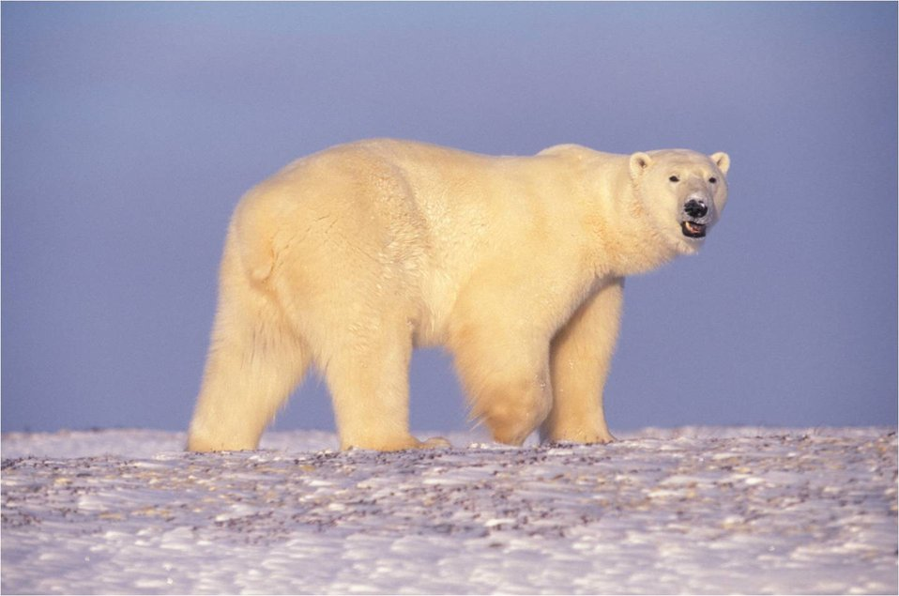
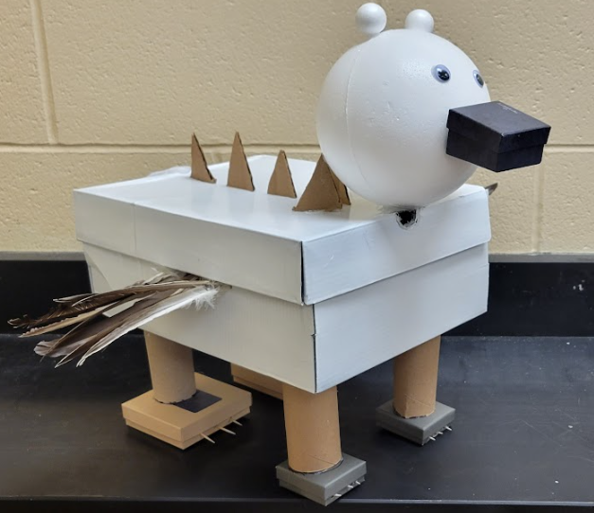
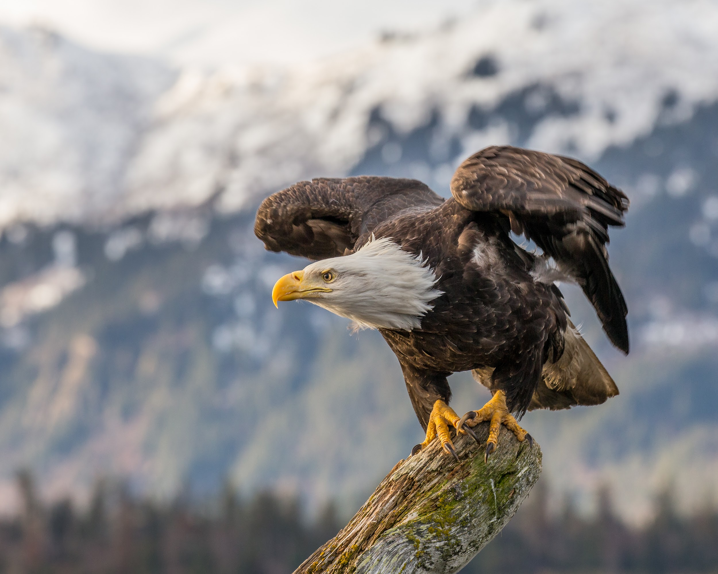
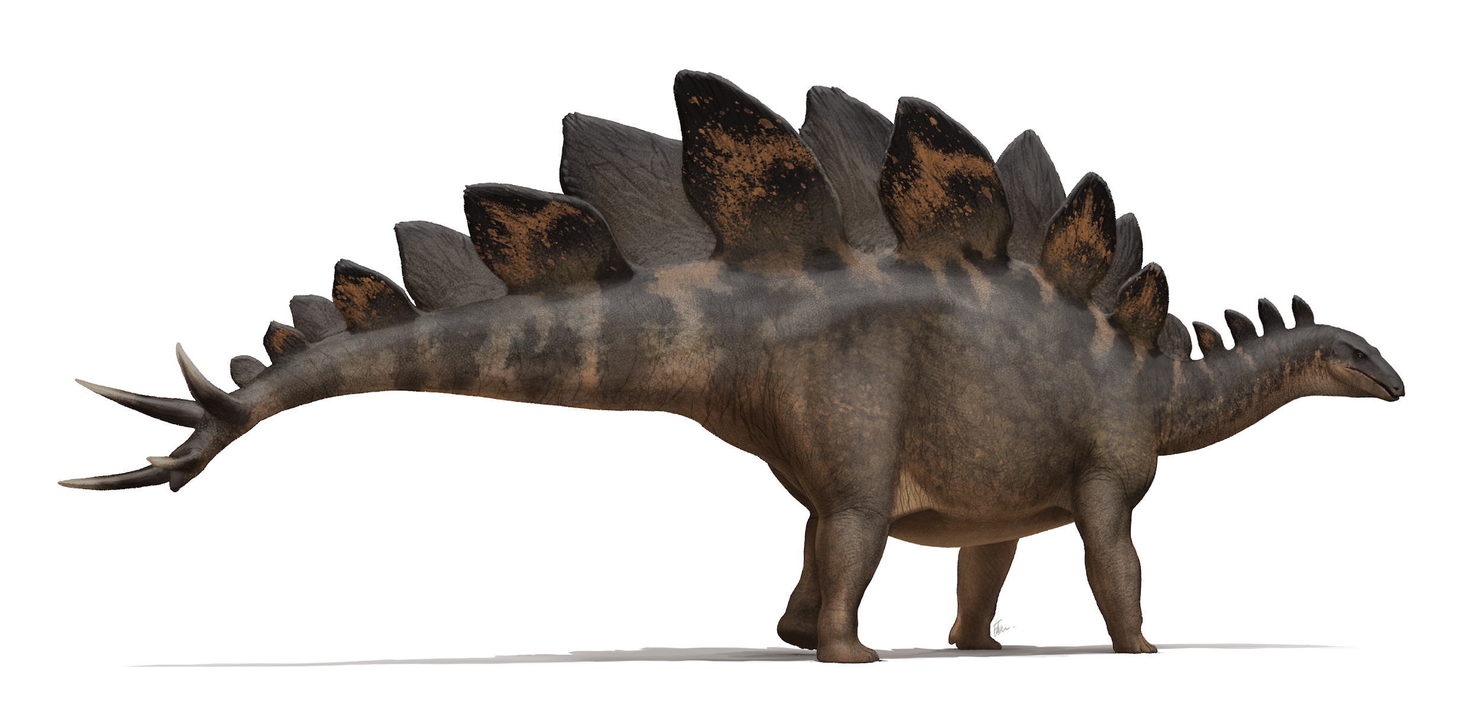

Slide 12
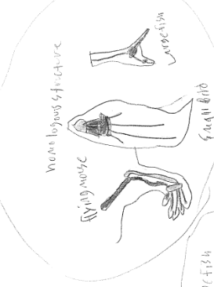
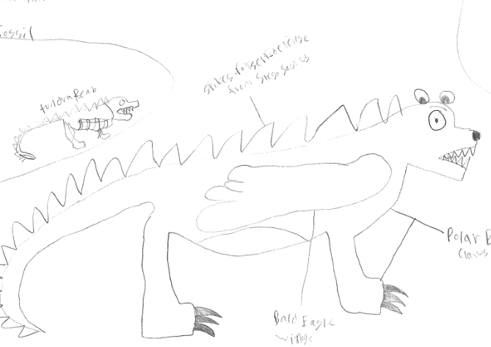
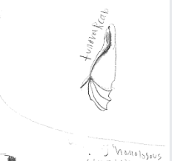
SKETCH OF SPECIES MODEL

Slide 13
Tail Tail Tail Tail
Large Fish Small Bird Tundra Reab Flying Mouse

Slide 14
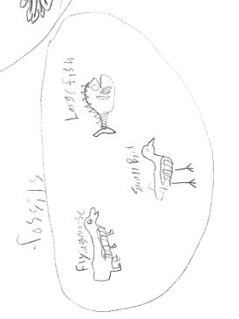
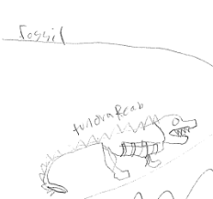

Slide 15
evolutionary descent
Traits
Natural selection
environmental
embryological development
Less

Slide 16
Our species is able to survive and thrive in this environment because of the many adaptations to fit it in the environment. It has thick white fur it is thick and soft so that the polar bear will stay warm and the fur is white so it can camouflage into the snow. It can also survive because it has claws that allow it to dig burrows to live in and the claws can also be used to hunt for prey like fish and birds. It has wings to escape from predators and catch prey like fish and birds by flying. And it also has sharp teeth that allow it to chew up its prey. So it is able to survive the cold tundra of planet D.

