Slide 1
Click here for the
project check in form
Click here for the
Grading Rubric
© 2022 Williams Hands On Science

Slide 8
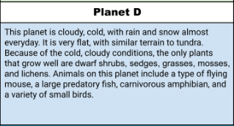

Slide 9
Hair/Fur
Birds, and plants
Their beak
Walk/fly
On the side of the head that is also angled. And their eyes are crossed.
It has a really high pitched scream as well as huge claws
Ice cave. They would sit on them

Slide 10
Beak
It uses their beak to attack and catch their prey by stabbing the pray with its beak.
Their long antennas.
Their long antennas, are used to since/hear their prey from miles away.
Very intelligent
They use their intelligence to outsmart and track their predators/prey.

Slide 11
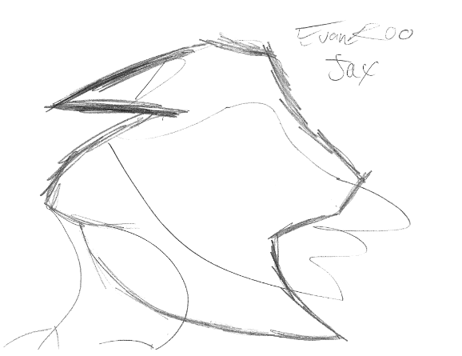
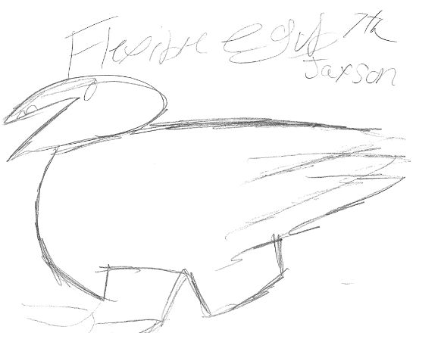
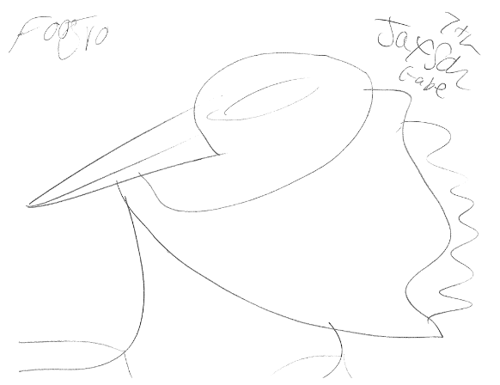
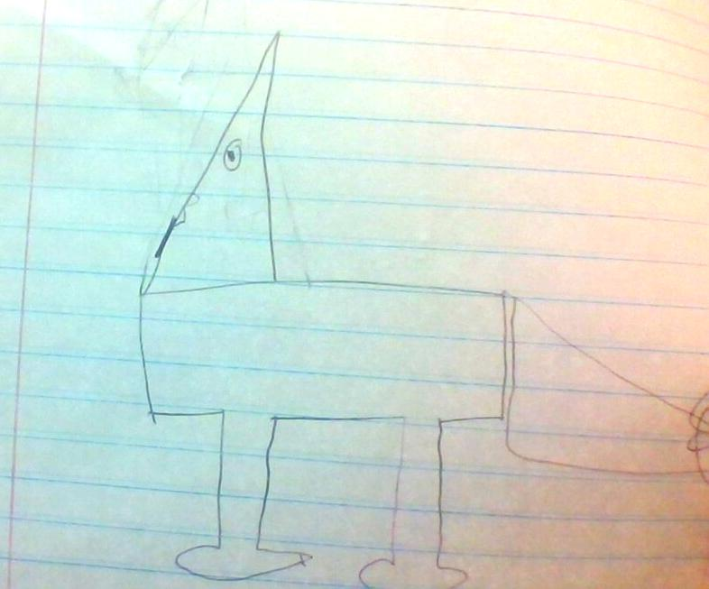
Even Roo Flexible egub FooGru Handerson lu

Slide 12
SKETCH OF SPECIES MODEL

Slide 13
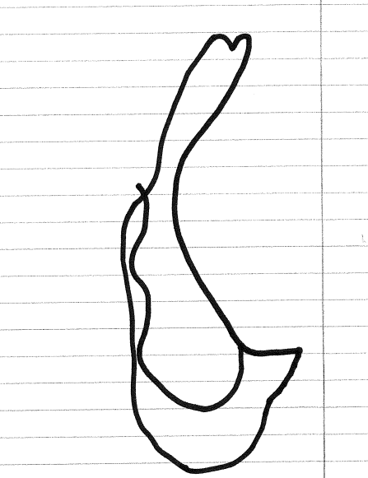
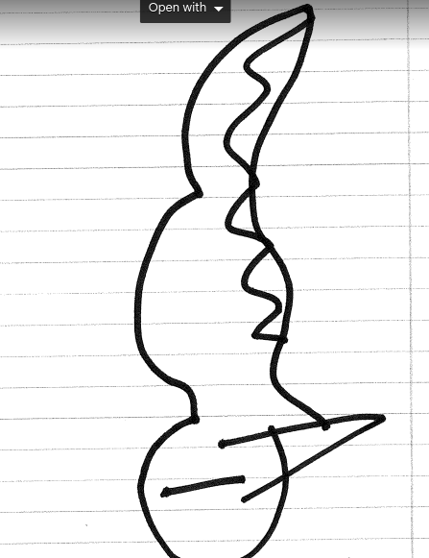
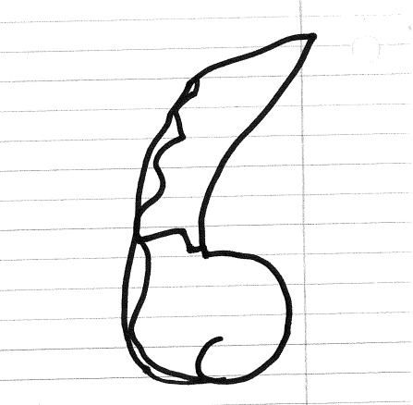
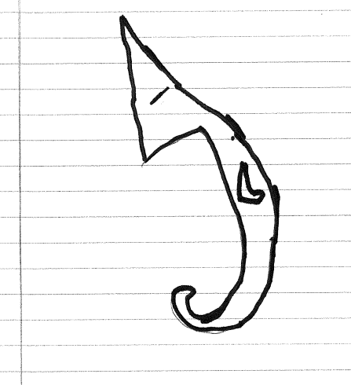
Even Roo
Flex. Egub
FooGru
Henderson Lu

Slide 15
evolutionary descent
embryological development
Natural selection
environmental
Traits
Less

Slide 16
Our species is able to survive with their heavy coat of fur. As well as claws to defend itself
They are able to adapt to their environment by hunt at night when its colder to find more vulnerable prey. They use there nocturnal instincts at there advantage to grow its fur as well as get better defenses.

