Slide 1
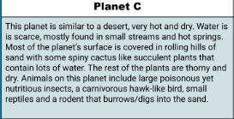
Teachers:
I post this in Google Classroom as an assignment they fill in
Planet C

Slide 2
Water is going to be in a patch in its hump
Cacti & small animals and rodents
Find it by using it’s long tongue by going underground
fly
Above nose
It can sense poison with its long tongue
Neck pouch

Slide 3
Physical Traits | How this trait favors your organism in the alien habitat
#1:Long Tongue | To find the small animals and the cacti
#2:Wings | To fly
#3:Neck pouch | To store water so it doesn't overheat

Slide 7
environmental
Natural selection
Traits
evolutionary descent
Less
embryological development

