Slide 1
Click here for the
project check in form
Click here for the
Grading Rubric
© 2022 Williams Hands On Science

Slide 8
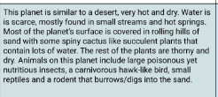

Slide 9
Thin coat with thinner tough skin
insects
Burrowing and catching it with sharp teeth and claws
walk
Mouse like face structure with big eyes and long eyelashes
Sand colored fur and sharp claws and teeth
Its habitat is in the ground

Slide 10
Strong paws for digging in the sand to burrow
Sharp teeth eating insects and defending themselves
Big ears to hear from far away

Slide 11
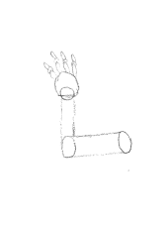
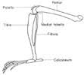
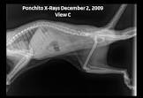
squirrel
mouse
Sugar glider
Rodemus

Slide 12
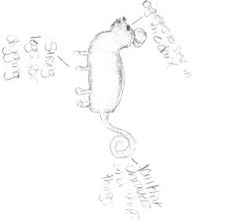
SKETCH OF SPECIES MODEL

Slide 13
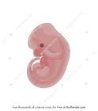
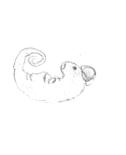
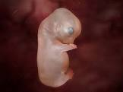
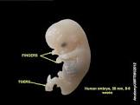
dog
mouse
cow
rodemus

Slide 14
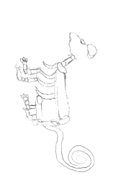

Slide 15
evolutionary descent
embryological development
Natural selection
environmental
Traits
Less

Slide 16
The Rodemus has had many adaptations to fit into its environment like its big ears, big eyes and long eyelashes and its sharp teeth and claws and it has a thin coat of tan fur to blend in with the sand. It has many sharing traits of a mouse which is one of its homologous structures that shares the similar structure of the leg.

