Slide 1
Click here for the
project check in form
Click here for the
Grading Rubric
© 2022 Williams Hands On Science

Slide 8
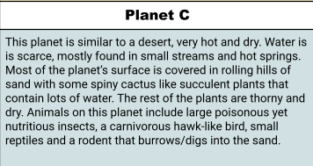
Planet C

Slide 9
Digs into the sand just low enough to cover its whole body, keeping it cool.
The small reptiles that inhabit the planet
While it is under the sand, it can feel the reptiles scurrying around it, it stays near the streams
walks
Has eyes on the side of its head, can see in front and behind it, also has blind spots
It is the color of the sand so it can blend in
It makes small tunnels under the ground as like a home base

Slide 10
Camouflage
Hides it from predators and prey
Long claws
Helps dig and catch prey
Sharp strong teeth
Helps break the tough exterior of the reptiles

Slide 11
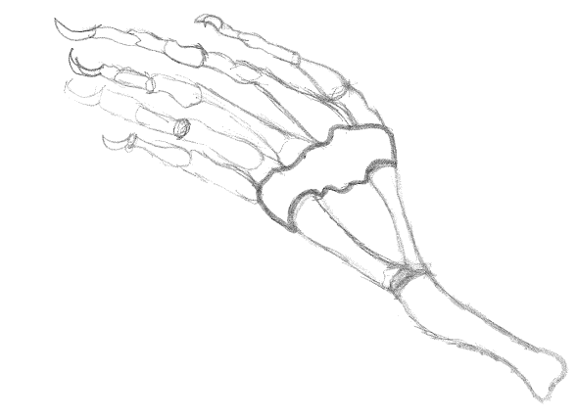
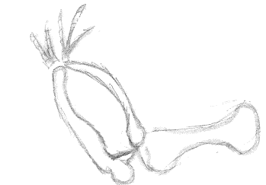
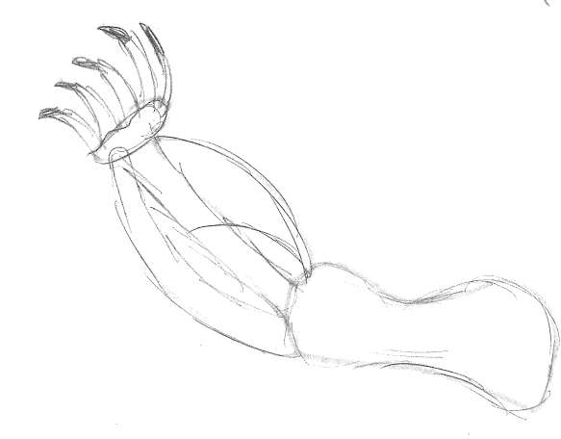
Lizzard
Hawk
Mouse

Slide 12
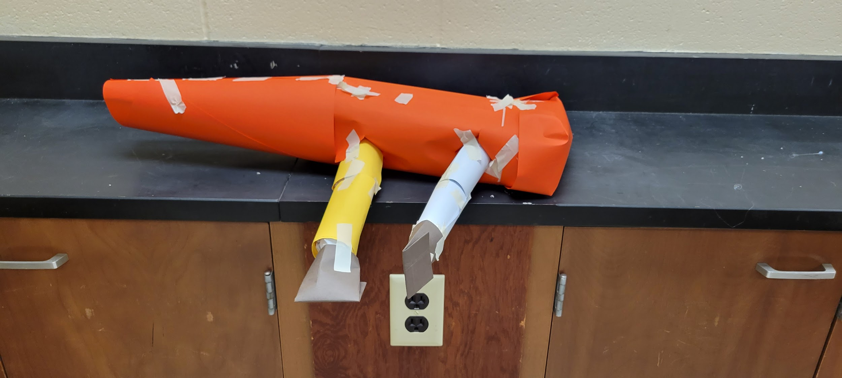
SKETCH OF SPECIES MODEL

Slide 13
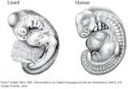
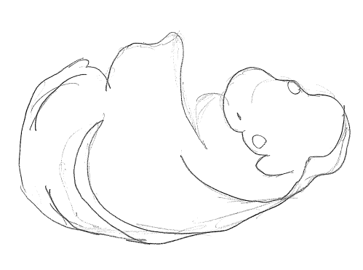

Slide 14
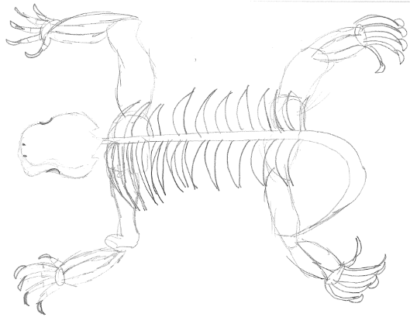

Slide 15
evolutionary descent
embryological development
Natural selection
environmental
Traits
Less

Slide 16
My species is able to survive natural selection because my species is able to adapt. Adaptation is when something evolves (changes) to fit its environment (habitat/place that it lives). Natural selection (something dying off because it is ill equipped for its environment), does not affect this species because it is equipped to survive its habitat. It has adapted and now has traits like, very long claws for hunting and digging. Sand like skin to camouflage itself. And very strong and sharp teeth to eat it’s prey. This species has similar bone structure to animals on our planet (seen on slide 11). Its embryology is also similar to animals our planet (seen on slide 13).

