Slide 1
Click here for the
project check in form
Click here for the
Grading Rubric
© 2022 Williams Hands On Science

Slide 8
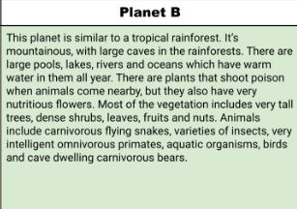
Planet B

Slide 9
By getting out of the water and hiding in the shade on land
Fruits, leaves and nuts
Drink the water from the lakes and ect. Go on land to get the food.
Walk and swim
On the front of it’s head but closer to the sides
By laying flat down at the floor of an ocean, lake, river, ECT.
By making a burrow

Slide 10
Big paws to help them swim and walk on land
The paws make it easy for them to swim in the water and move around in the water. But they also make it so they can explore the forest and caves
Lungs that cause them to stay in water for long periods of time, but also on land
The lungs make it so they can switch from being in the water to being on land with no problem
Sharp teeth to eat food and kill other animals
Their teeth make it so they are able to eat fruits, leaves and nuts but their teeth also

Slide 11
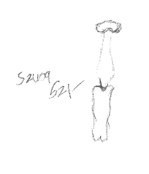
Dog
Bird
Human

Slide 12
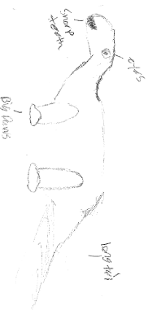
SKETCH OF SPECIES MODEL

Slide 13
Cat
Human
Bird

Slide 15
evolutionary descent
embryological development
Natural selection
environmental
Traits
Less

