Slide 1
Click here for the
project check in form
Click here for the
Grading Rubric
© 2022 Williams Hands On Science

Slide 8
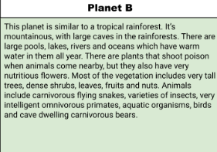
Planet B

Slide 9
Scales allow thermal energy to pass through into it.
It will eat small aquatic creatures, similar to fish.
It blends into the environment like a chameleon, and jumps out at vulnerable prey.
Swimming with fins.
Eyes are on top of head
It is always blending into its surroundings, so the predator can’t see it.
It makes a burrow at the bottom of a river, and let's underwater poisonous plants grow around to protect the burrow with its young inside.

Slide 10
Back Fins
Allows it to swim at high speeds
Pharyngeal Slits
Allows it to breath underwater
Strong Front Arms
Allows it to burrow into the ground

Slide 11
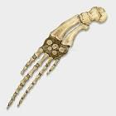
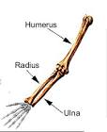
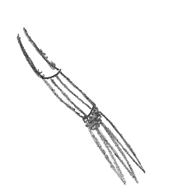
Whale
Human
Bird
Slytherfish

Slide 12
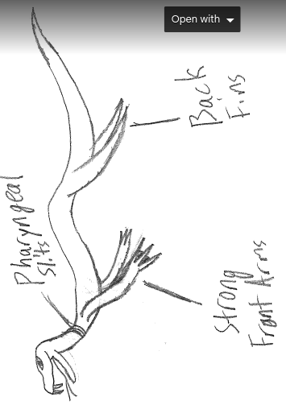
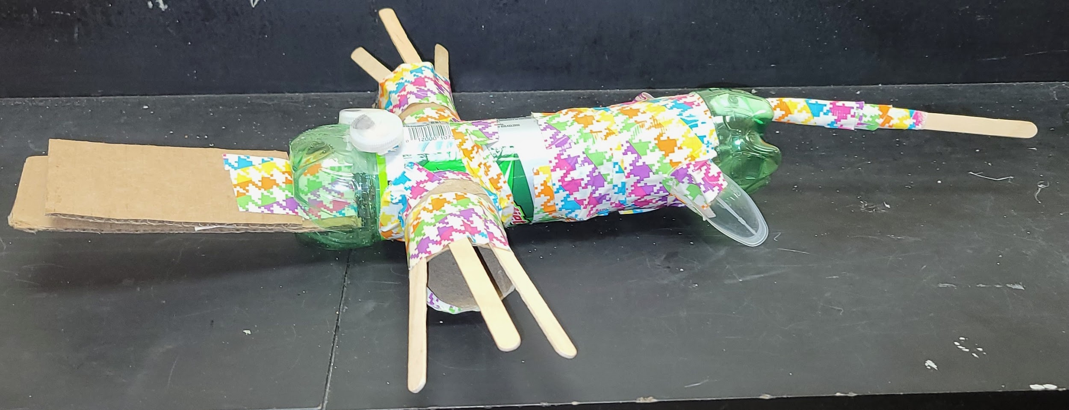
SKETCH OF SPECIES MODEL

Slide 13
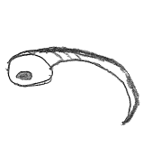
Fish
Salamander
Pig
Slytherfish

Slide 14
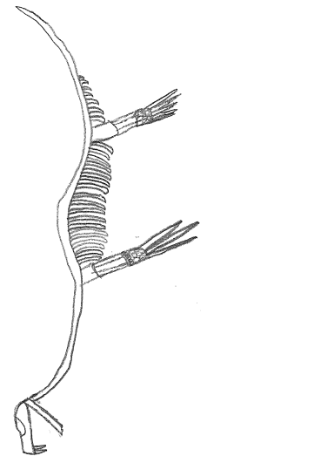

Slide 15
evolutionary descent
embryological development
Natural selection
environmental
Traits
Less

Slide 16
The Slytherfish has evolved from a snake, and developed back fins and strong front arms for traits. It has also adapted to the environment and developed gills to breathe underwater. The Slytherfish has homologous structures to whales, humans and birds and it’s embryology is similar to fish, salamanders, and pigs. Also, the Slytherfish was naturally selected to survive and thrive underwater with its adaptations.

