Slide 1
Click here for the
project check in form
Click here for the
Grading Rubric
© 2022 Williams Hands On Science

Slide 8
Planet D

Slide 9
Its fur will keep it warm or cool
Flying mice and small birds
Its tail can scratch animals and it can pounce on the animals from above
Swim and fly
Eyes at a diagonal front and side
The spiked tail and by flying
They will live underwater since they have gills and they when they are old enough to fly they will be on they’re own

Slide 10
Fur stay warm in the habitat
Spiked Tail Hit prey and stun them so it can catch the prey
Spots Scare predators away with spots that look like eyes

Slide 11
Hyendrag dog Large Predatory Fish Carnivorous Amphibian Flying Mouse

Slide 12
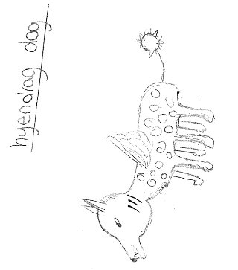
SKETCH OF SPECIES MODEL

Slide 13
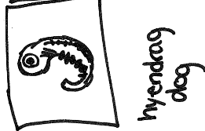
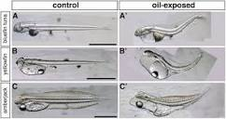
Hyendrag dog large predatory fish carnivorous Amphibian Flying Mouse

Slide 14
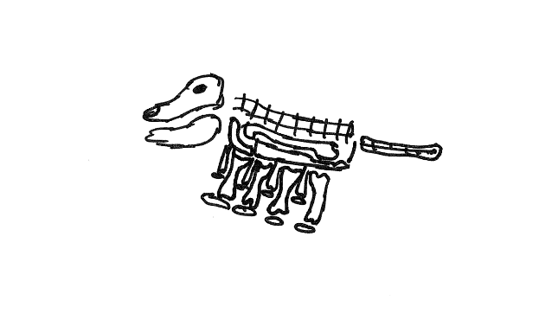

Slide 15
evolutionary descent
embryological development
Natural selection
environmental
Traits
Less

Slide 16
The Hyendrag Dog can survive in the wild because of natural selection, adaptation, embryology, homologous structures, and the habitat/environment.
Natural selection helps it because the hyendrag dogs with the desirable traits are more likely to pass those traits on to their offspring, the desirable traits are their spiked tails and sharp teeth.
Adaptation helps it because they have adapted over time to have fur for the cold and gills for underwater.
The embryology shows the creature has a tail and gills. The tail and gills usually go away in other species, but in this particular species the tail and gills do not go away and those traits are what helps it to survive in the wild.
Homolgous structures help it to be closer to other animals in the environment and to use its structures to its advantage.
The habitat helps it because of the way it can hide, swim, and much more in the wild.

