Slide 1
Click here for the
project check in form
Click here for the
Grading Rubric
© 2022 Williams Hands On Science

Slide 9
Feathers
Animals
Its teeth and hands
fly
It can't see but its other senses are better
It can make a scent that makes other things go away
If it finds a place that it wants to stay it can smell if there's something there or not.

Slide 10
Feathers
It’s mainly cold
Wings
If it needs to fly it can
Sharp and needle like teeth
Get food

Slide 11
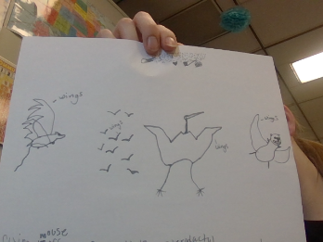
Flying mouse small birds pterodactyl tarow

Slide 12
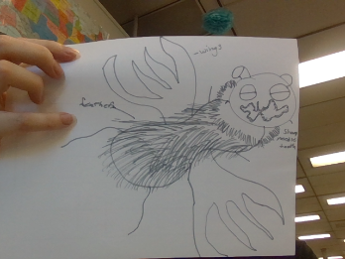
SKETCH OF SPECIES MODEL

Slide 13
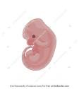
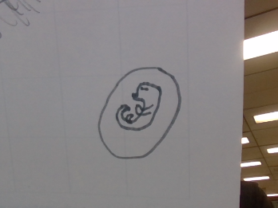
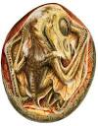

Slide 14
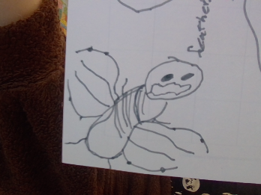

Slide 15
Traits
evolutionary descent
Natural selection
environmental
Less
embryological development

Slide 16
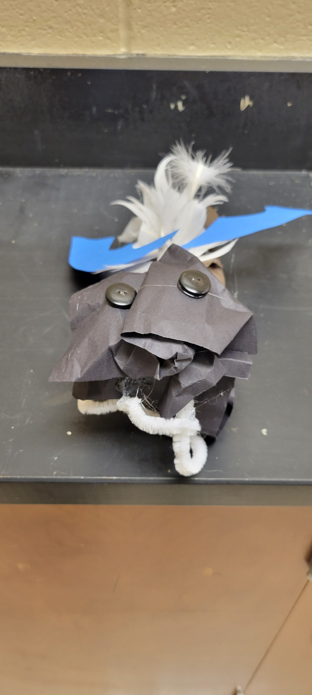
The traits I have given to my spesheys will protect them from the habitat/environment and with natural selection. There embryo follows embryology with the structure.
Ik it's not a paragraph

