Slide 1
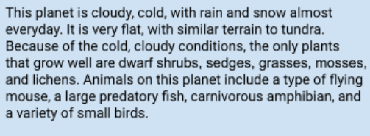
Teachers:
I post this in Google Classroom as an assignment they fill in
Planet D

Slide 2
Has very long fuzzy hair
Birds, insects, and land animals
Has long claws to catch food and break ice to get water
Fly and walk
Eyes are on front and tiny to confuse the predators
It can fly and has long claws for defense it’s eyes are also tiny so the predators don’t know which side they need to approach to sneak up on it
They have a little pouch for their young and they live in caves

Slide 3
Physical Traits | How this trait favors your organism in the alien habitat
#1: wings | Helps it get away from predators
#2: long warm fur | Keeps it warm in the really cold
#3: long sharp claws | Helps it catch food, defend itself, and break ice for water

Slide 4
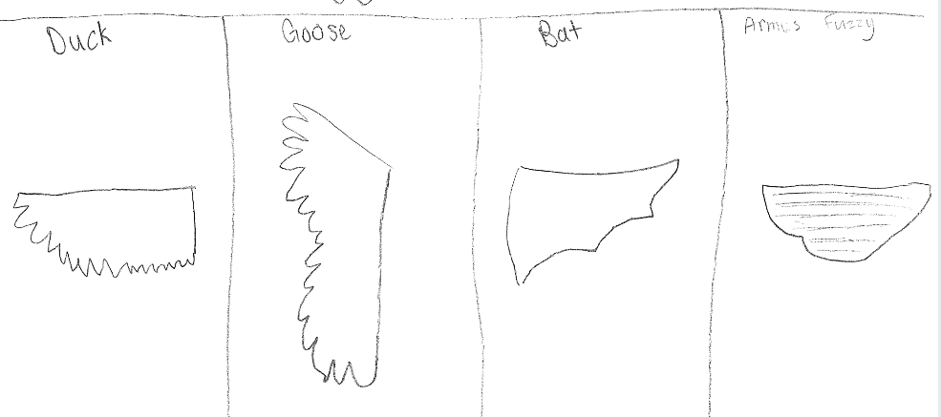

Slide 5
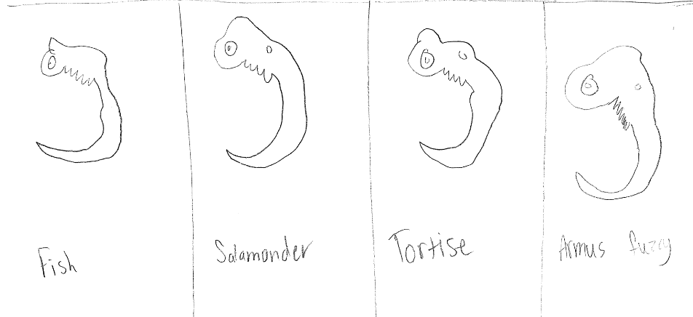

Slide 6
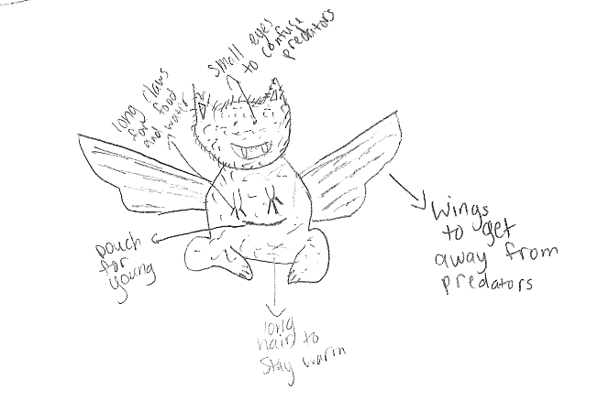

Slide 7
evolutionary descent
embryological development
Natural selection
environmental
Traits
Less

Slide 8
The Armus Fuzzy has very long and fuzzy fur to keep it warm on Planet D in the cold. It also has long claws to catch food and break ice to get water. This animal also has wings to get away from predators. To protect its babies it has a little pouch on the front of its body to keep it warm and safe. To protect itself it has really tiny eyes so predators can’t see them so they don’t know which side to sneak up on. The biggest threat to the Armus Fuzzy is animals bigger than it but it can overcome that because it can fly and and get away from animals that can’t fly. It also can still fly with the baby in it’s pouch. Both the female and male have the pouch for the baby.

