Slide 1
Click here for the
project check in form
Click here for the
Grading Rubric
© 2022 Williams Hands On Science

Slide 8
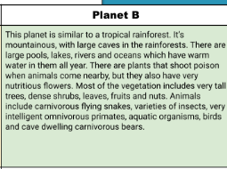

Slide 9
Staying in the water
Seaweed, coral, algae
teeth
swims
On top of the head side by side
By blending in
Blending in

Slide 10
Fins
Fins help it swim in the ocean
The tail helps it move faster while swimming
tail
gills
Gills to help it breath in the water

Slide 11
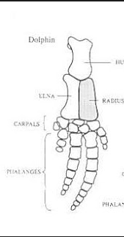
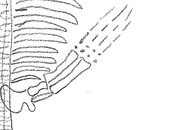
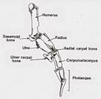
Penguin
Whale
dolphin

Slide 12
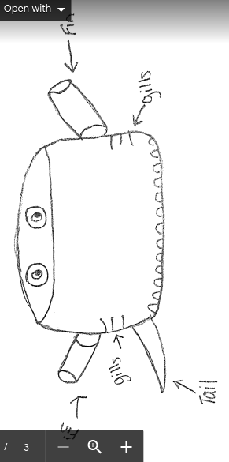
SKETCH OF SPECIES MODEL

Slide 13
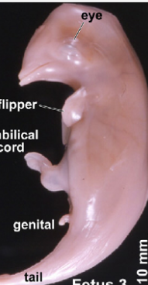
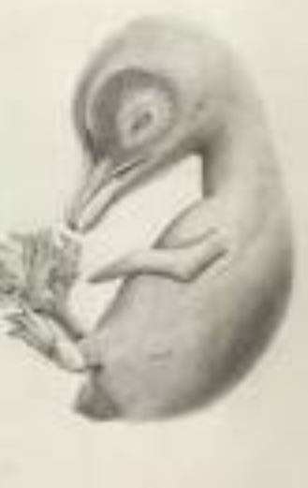
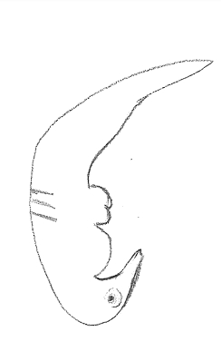
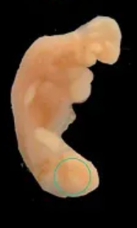

Slide 14
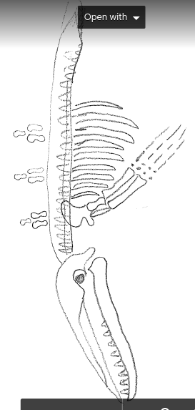

Slide 15
evolutionary descent
embryological development
Natural selection
environmental
Traits
Less

Slide 16
Our species can survive in our habitat because of its traits. It has gills which helps it breathe underwater, it has fins which help it swim, and it has a tail to help it swim smoother. It’s natural selection is the ocean. It’s embryo is similar to other ocean animals because of these traits. It’s homologous structure is it’s fins which is similar to other ocean species. It’s adaptation is it’s gills which helps it breathe underwater.

