Slide 1
Click here for the
project check in form
Click here for the
Grading Rubric
© 2022 Williams Hands On Science

Slide 8
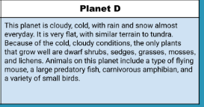
Planet D

Slide 9
Keeps warm with blubber
Herbivore (eats the plants)
Has flat teeth to eat plants
Walks with 4 legs
6 eyes, three vertical on each side of face
Claws with with venom
Poaches to carry young, huddles in packs for warmth and safety.

Slide 10
Blubber and fur
Keeps it warm
Venomous claws (does not affect breed)
Protects it from predators
Pouch for young
To keep young safe and warm

Slide 11
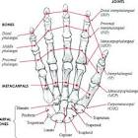
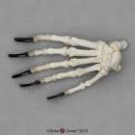
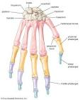
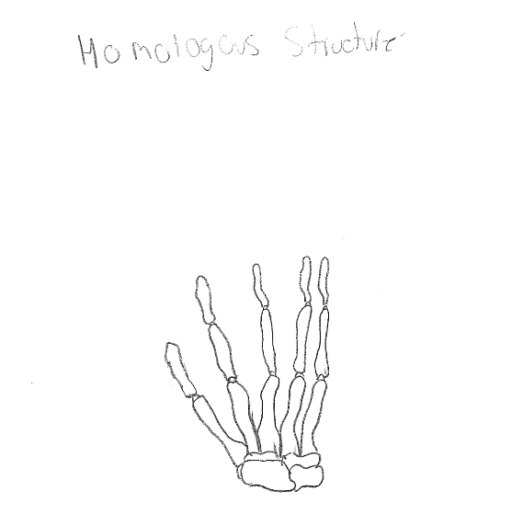
Bear
Human
Chimp
Fizzlesticks

Slide 12
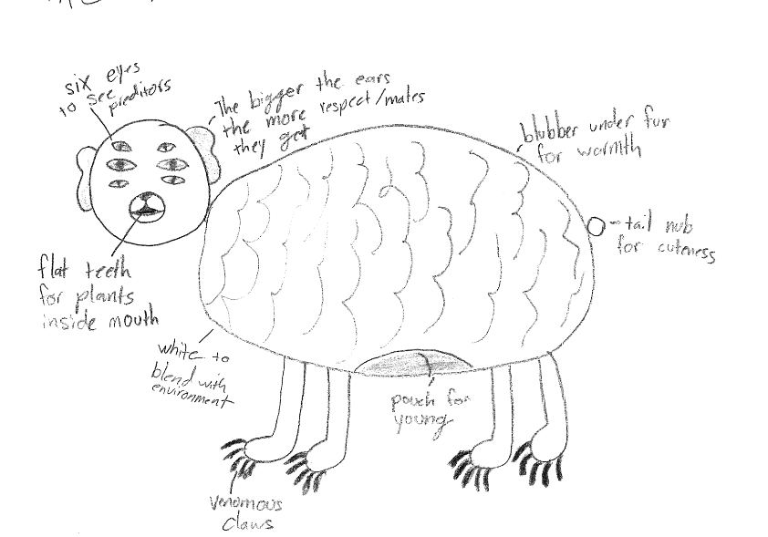
SKETCH OF SPECIES MODEL
Fizzlesticks

Slide 13
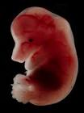
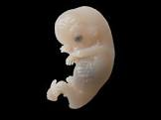
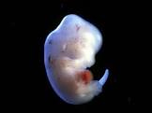
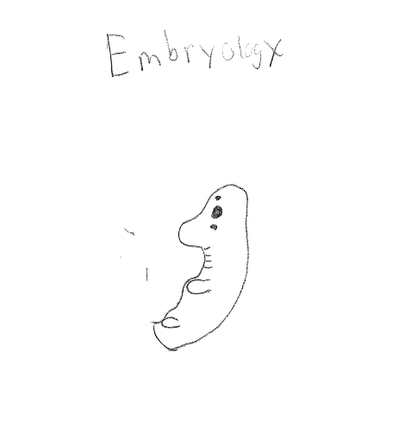
Bear
Human
Fizzlesticks
Chimp

Slide 14
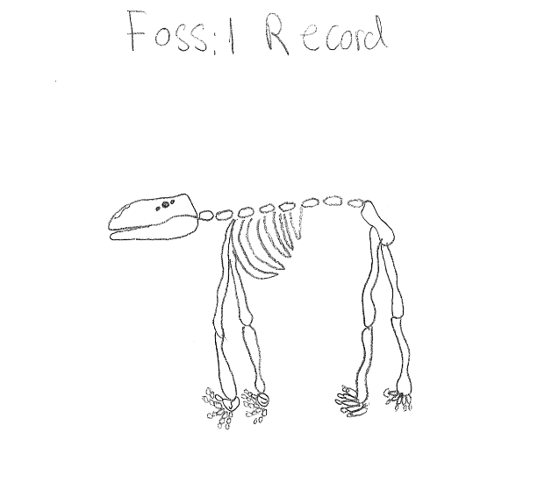

Slide 15
evolutionary descent
embryological development
Natural selection
environmental
Traits
Less

Slide 16
Our species, the fizzlesticks, is able to survive the cold, harsh environment of Planet D because of its adaptation of having blubber under its fur to keep warm. This trait keeps it warm throughout the cold, but it also has venomous claws. The fizzlesticks with venomous claws have a better chance at survival because the claws are its only means of defence. Also, natural selection shows itself when the fizzlesticks doesn't have flat teeth to eat the plants. If it has sharp teeth it will have to eat other animals and their stomach can’t handle it. The last thing is the ears of the fizzlesticks. They serve the purpose of finding a mate as well as hearing. All of these traits help the fizzlesticks survive and reproduce in this harsh environment.

