Slide 1
Click here for the
project check in form
Click here for the
Grading Rubric
© 2022 Williams Hands On Science

Slide 8
Planet A
A semi-arid desert. Springtime all year with mild temperatures. Ponds,streams and lakes that periodically dry up in summer. Planet is hilly and dense thorny dry shrubs. Vegetation also includes tall trees with hanging fruit and a smaller plant which bears nuts. Animals include large fanged carnivorous rodents and tiny jumping mice which live underground,incests,flightless birds,a fast deer-like herbivore that shoots poisonous quills like a porcupine and a carnivorous wolf that blend in well with the dense shrubs.

Slide 9
Sunbathes in the sun and when to stay cool stays in a body of water(pond)
Tiny jumping mice and insects
Get water from ponds/streams. Sneak and pounce on food and inject poison through tail.
Slide,fly and swim
On the right and left next to the snout
Hang in trees and can fly decent distance away
Burrows in ground and burrows in trees. Feed,protect and teach its young how to live and survive in the world.

Slide 10
The sharp pointed tail will inject poison into its predators in order to defend themselves and also be able to catch prey
Sharp pointed tail
Can only be in air for short periods of time but keeps distance from predators
Wings `
Has skales that help move along the ground smoother and has to shed skales like one of its descendants (snake).
Skales

Slide 11
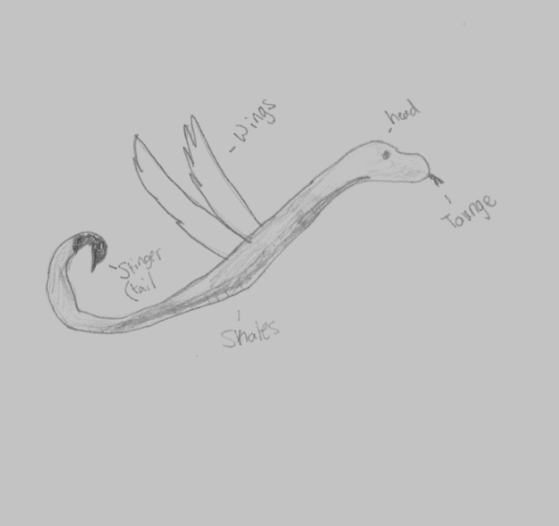
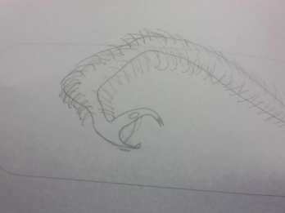
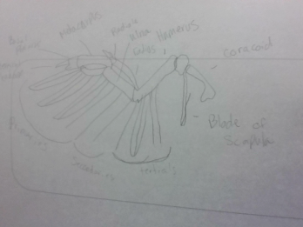
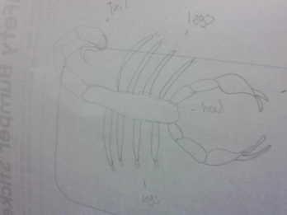
Snake
Bird
Scorpion
stinger

Slide 12
SKETCH OF SPECIES MODEL

Slide 13
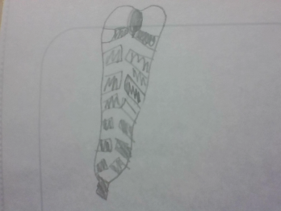
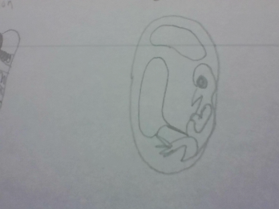
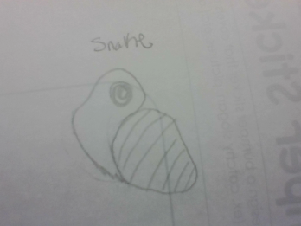
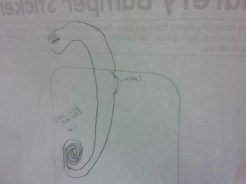
tail
wings
Body
All 3
Scorpion
Bird
Snake

Slide 14
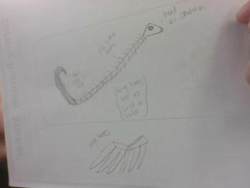

Slide 15
Natural selection
evolutionary descent
embryological development
environmental
Traits
Less

Slide 16
The snake had a scorpion tail which inflicts a poisonous sting on its prey. And it also has wings to fly to get away from predators but can only go a short distance though it does help with transportation, though it also drains the energy of the snake. We can even see these features on the embryo of the creature.it also appears that the snake can hold water inside of a certain part of its body for a certain amount of time, that time being for about 4 weeks.

