Slide 1
Click here for the
project check in form
Click here for the
Grading Rubric
© 2022 Williams Hands On Science

Slide 8
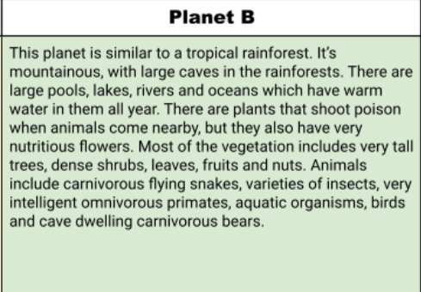
Planet B

Slide 9
The body heat stabilizes according to the weather outside.
Rabbits, bears, deer, large mammals
The poison from the leaves on the snake catch water and it’s absorbed into the snake. Poisonous leaves/plants on the snake can trap and kill animals. Leaving the snake the rest of the way to eat it.
Swim, slither, climb trees, 12 hour breath underwater. Fast swimmer underwater.
Normal snake eyes but it can see as a human can.
Camouflage and disappearing into the bottom of lakes, ponds, or rivers.
Stays mostly in deep planted areas. Lots of moss and vegetation.

Slide 10
Really long body
Helps to detect motion if any predators are near
No limbs
Helps from getting attacked
Poisonous vegetation on its body
Makes it much easier for camouflage & catching prey

Slide 11
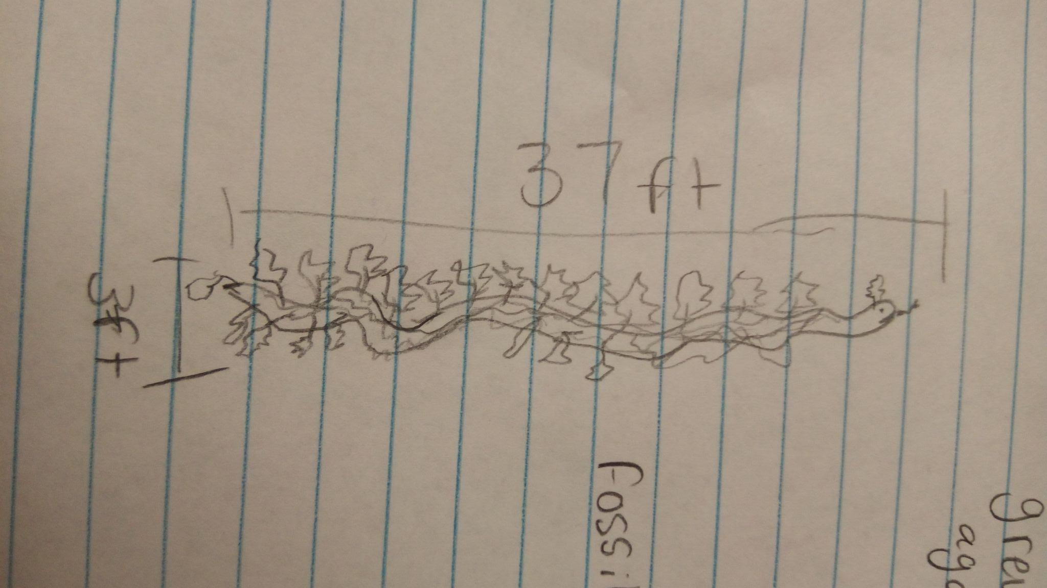
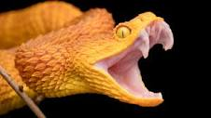
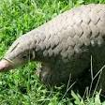
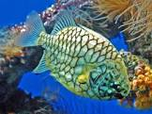
Pangolin
snake
Fish

Slide 12
SKETCH OF SPECIES MODEL

Slide 13
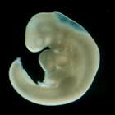
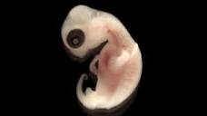
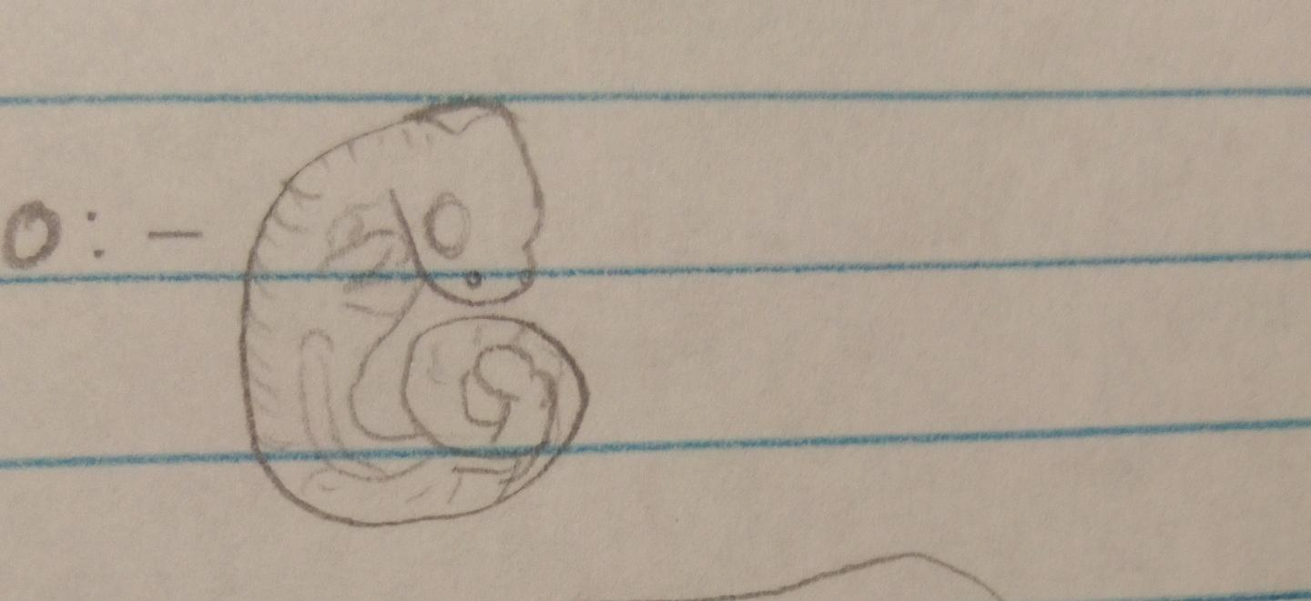
snake
fish
turtle

Slide 14
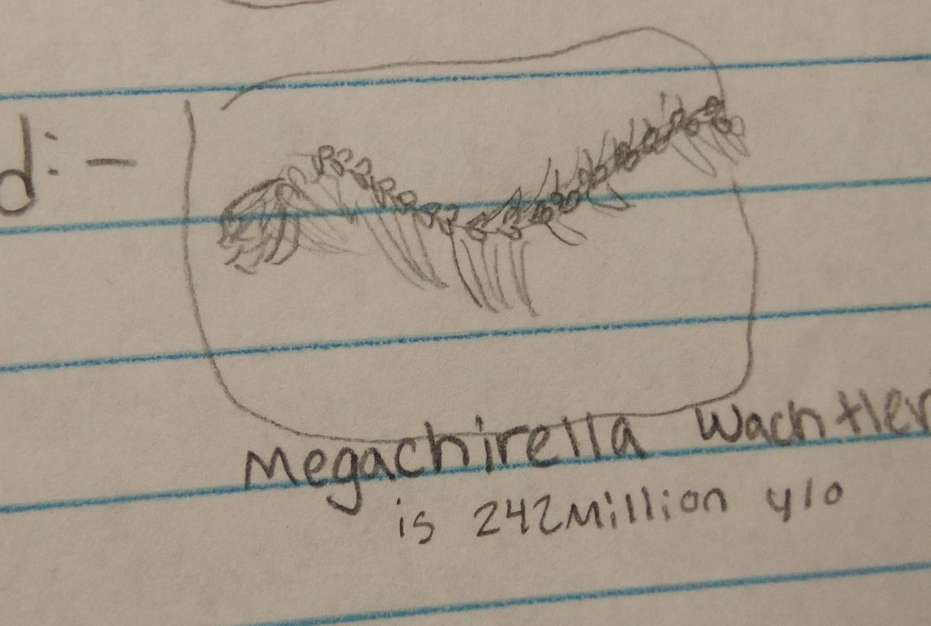

Slide 15
evolutionary descent
Traits
Natural selection
environmental
embryological development
Less

Slide 16
Our species can survive and thrive through planet B with the plants and moss on it. Since the plants try to poison the animals with venom, our species has leaves, and vegetation to disguise itself as a plant when going in a poisonous plant path. It is clear/see through so it can go into water and look just like algae or a water plant when hiding from predators.

