Slide 1
Click here for the
project check in form
Click here for the
Grading Rubric
© 2022 Williams Hands On Science

Slide 8
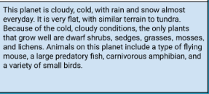
Planet D

Slide 9
Thick white fur, thick fur to help it stay warm and white fur to help blend in
Fish, moss, twigs, bark and leaves
The animal will catch the food with its teeth, and will get water from the ocean.
Swim, and walk
They have eyes with very good vision
Blend in with the snow with its white fur.
Shelter is in the water, it will care for its young by protecting the young.

Slide 10
White fur
Helps blend in
Wings
Helps have a shelter/place to live
Teeth
Helps catch its food

Slide 11
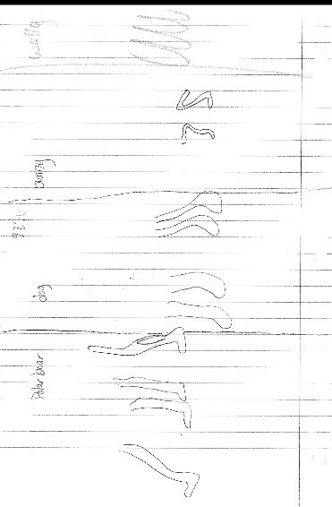

Slide 12
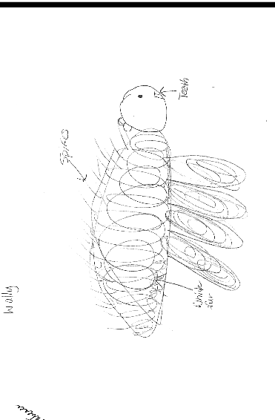
SKETCH OF SPECIES MODEL

Slide 13
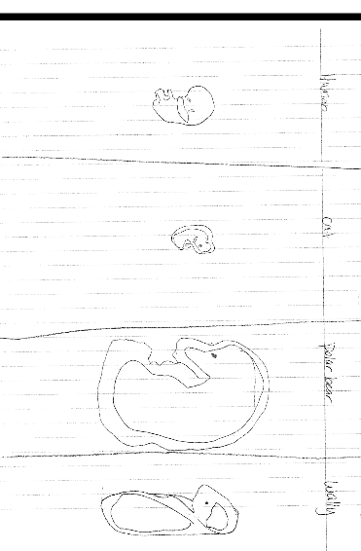

Slide 14
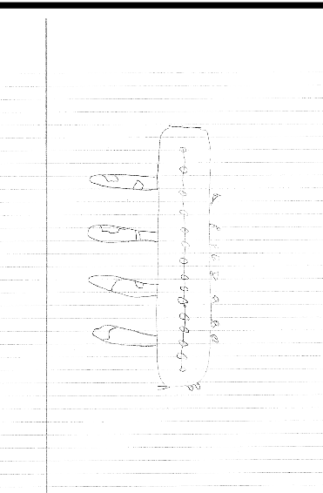

Slide 15
Natural selection
evolutionary descent
embryological development
environmental
Traits
Less

Slide 16
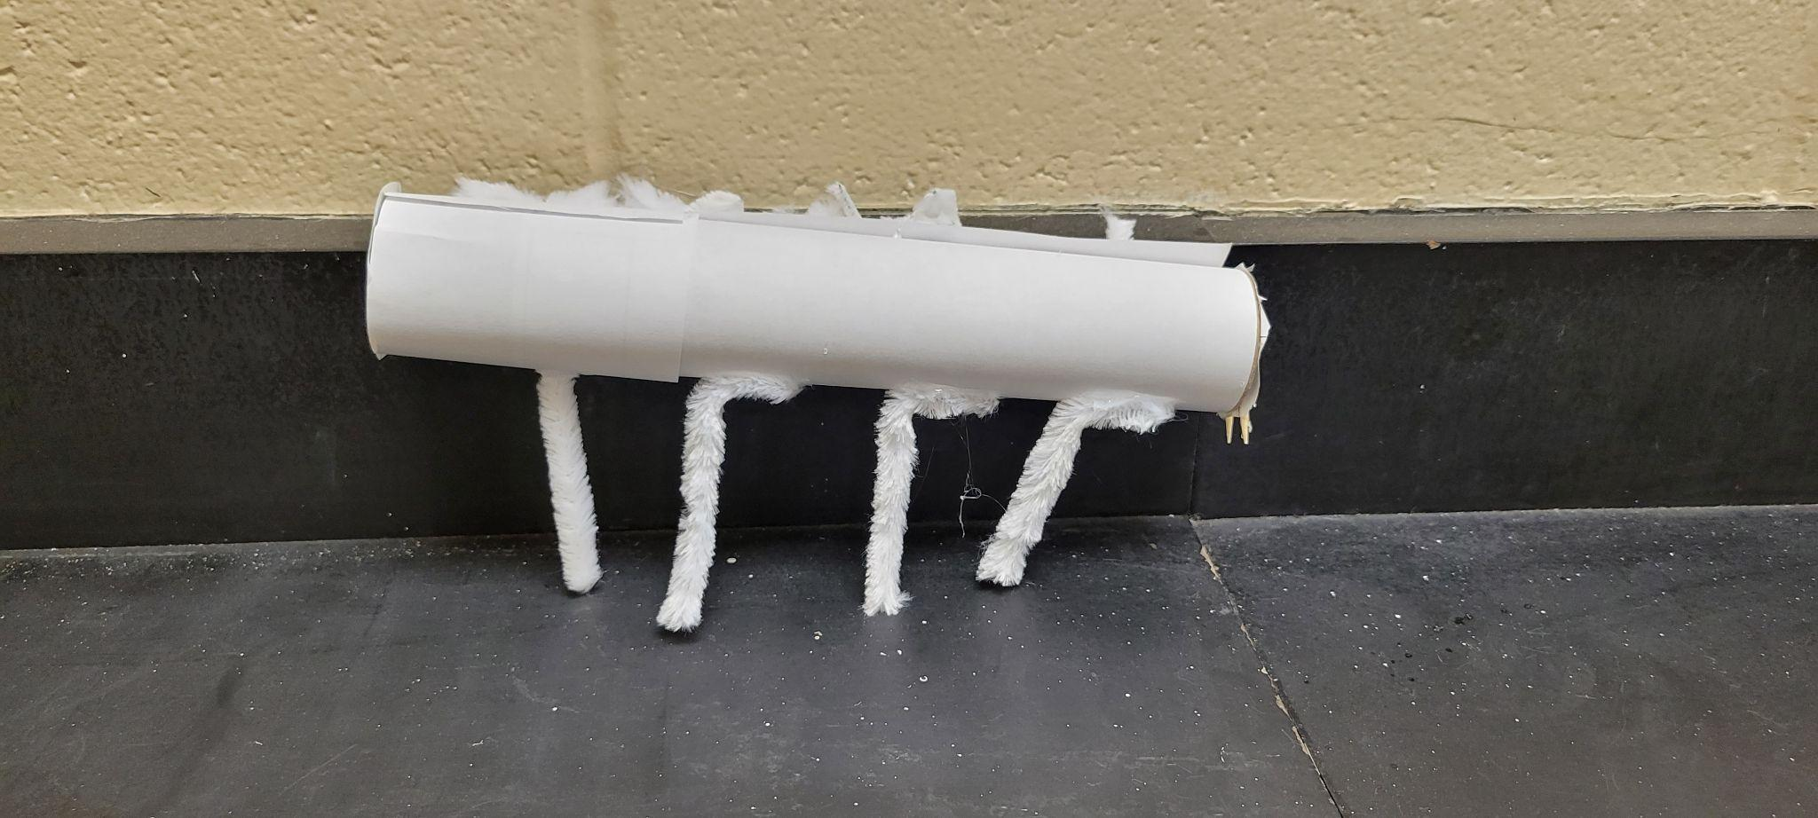
My species Wally is able to survive in his habitat because of his physical traits which include; white fur, ears that have very good hearing, sharp strong teeth, eyes with very good eyesight. Wally does good with adaptation. Homologous Structures between various organisms living on the planet you choose enabled you to show natural selection. Embryology is the most important stage because if they were to grow wrong everything could go wrong. This is my summary of designing a species.

