Slide 1
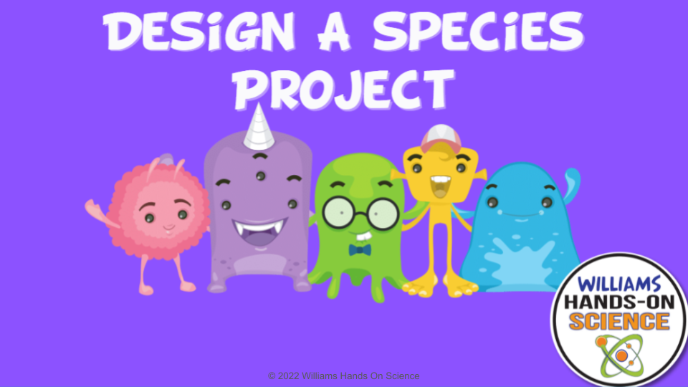
Click here for the
project check in form
Click here for the
Grading Rubric
© 2022 Williams Hands On Science

Slide 2
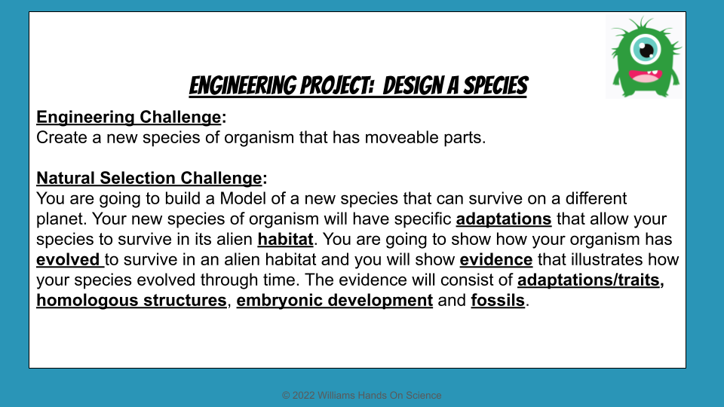

Slide 3
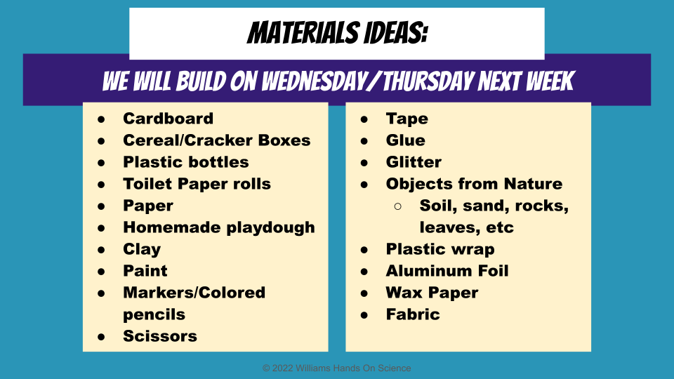

Slide 4
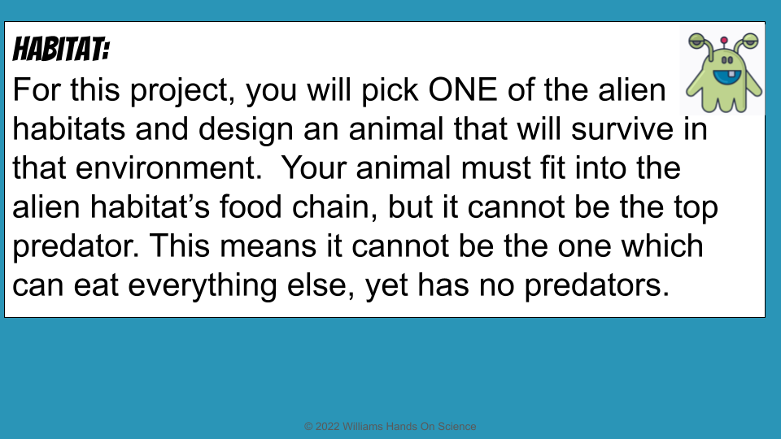

Slide 5
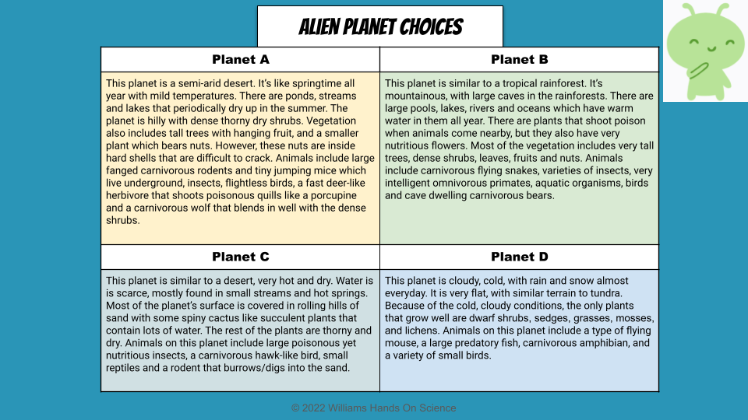

Slide 6
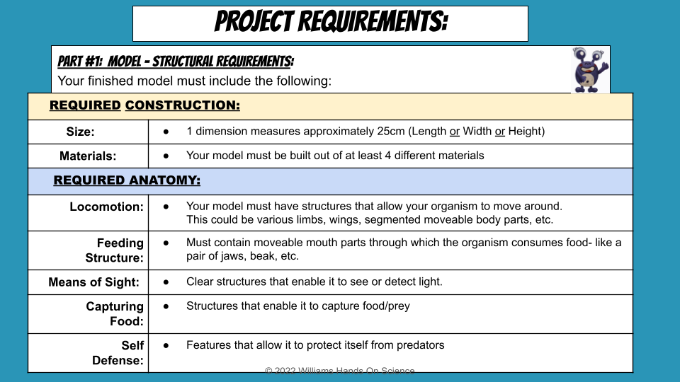

Slide 7
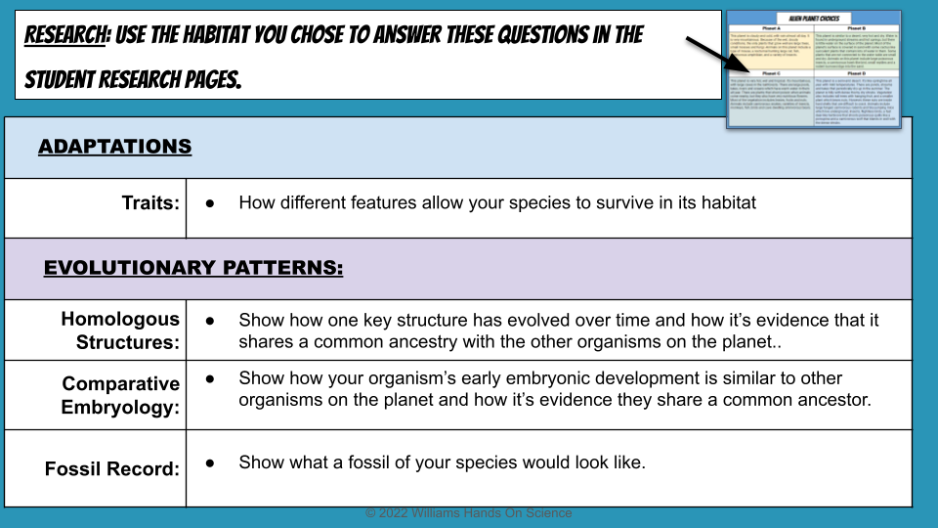

Slide 8
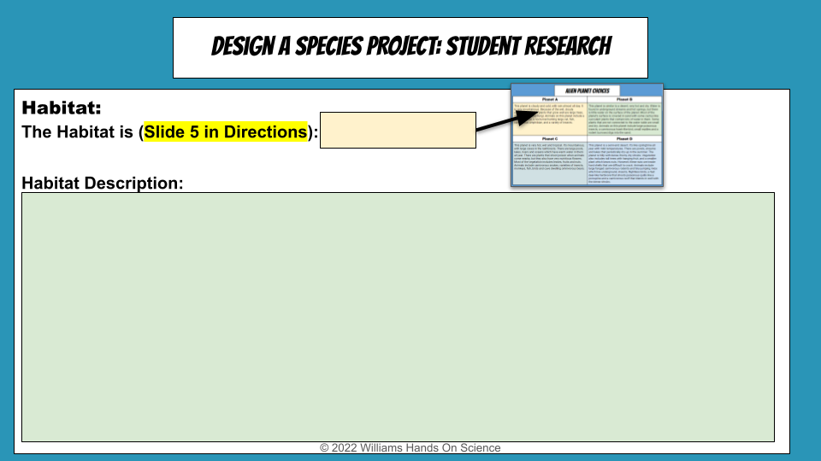
Planet B
This planet is similar to a tropical rainforest. It’s mountainous, with large caves in the rainforests. There are large lakes, pools, rivers and oceans which have warm water in them all year. There are plants that shoot poison when animals come nearby, but the also have very nutritious flowers. Most of the vegetation includes very tall trees, dense shrubs, leaves, fruits and nuts. Animals include carnivorous flying snakes, varieties of insects, very intelligent omnivorous primates, aquatic organisms, birds and cave dwelling carnivorous bears.

Slide 9
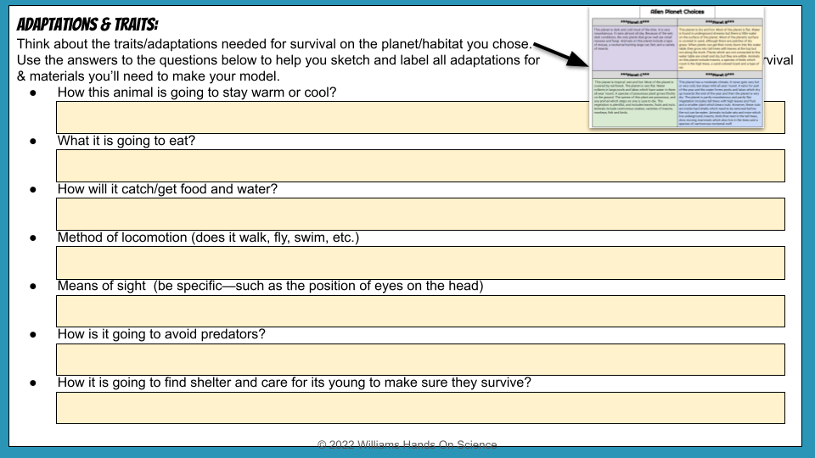
It drinks the lake water to stay cool and burrows in a hole to stay warm
Plants and small animals (mostly plants)
It has razor sharp teeth and a strong grip.
Walks kind of like a dog
In the front
It’s very quick and very small so it is easy to get away
It lives in a small cave

Slide 10
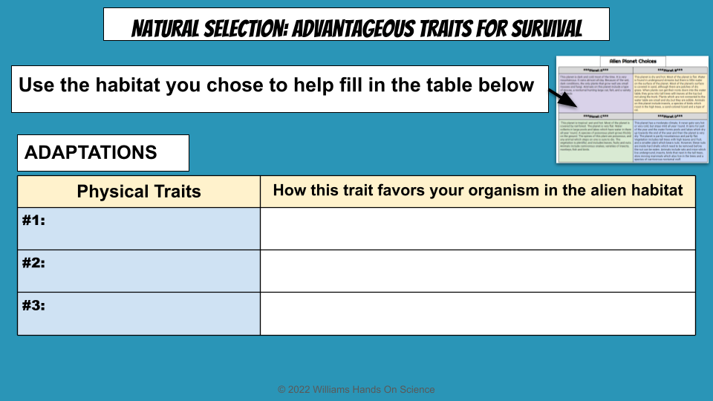
Physical Traits | How this trait favors your organism in the alien habitat
#1: it can absorb poison and spit it back out anytime | The trees spit out poison so it helps protect it, and it’s good for catching prey.
#2: A good grip | It has a good grip so it is easy for it to climb trees to reach food and grab it or grab its prey.
#3: Sharp teeth | It has really sharp teeth so it can help break down food or crack open nuts and fruits.

Slide 11
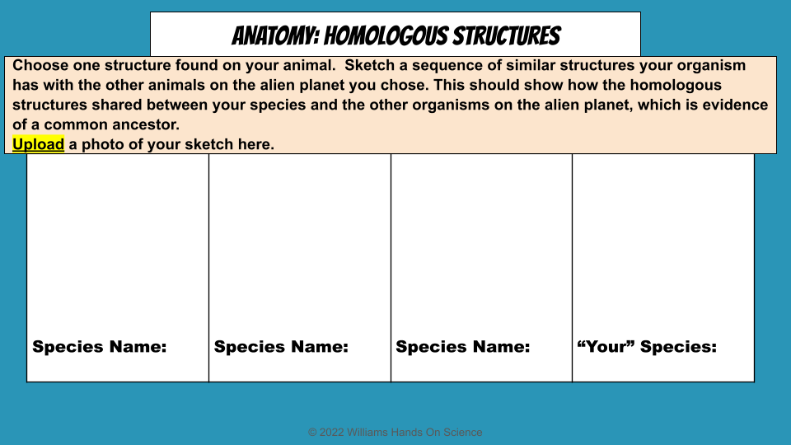

Slide 12
SKETCH OF SPECIES MODEL

Slide 13
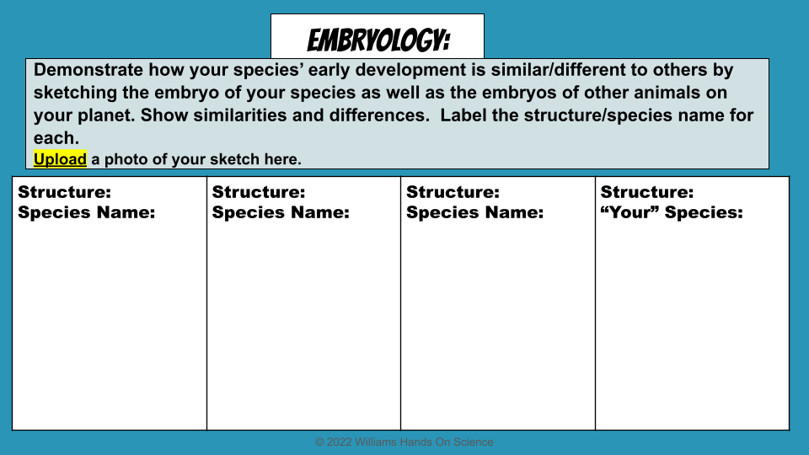

Slide 14
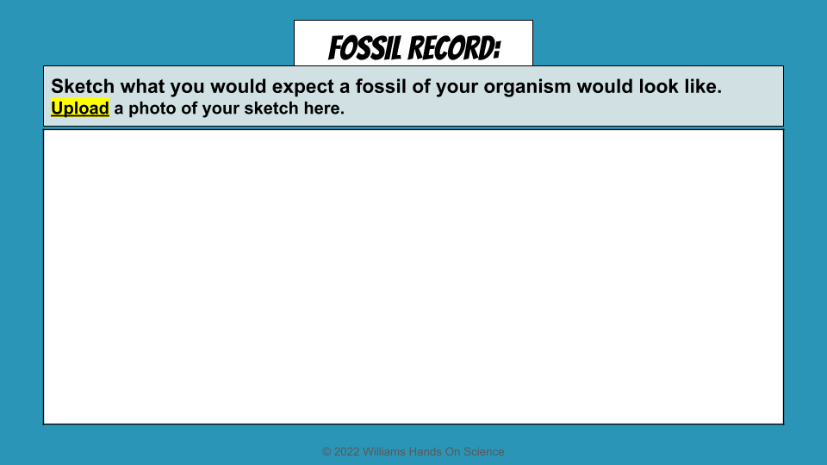

Slide 15
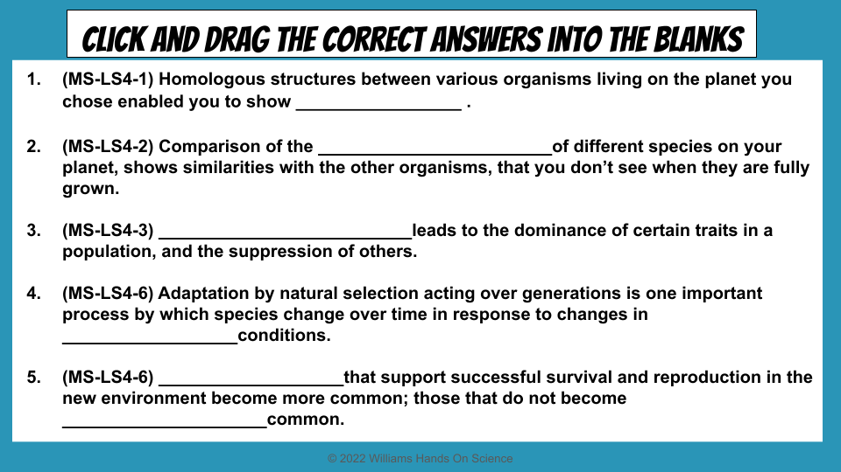
embryological development
Traits
evolutionary descent
environmental
Natural selection
Less

Slide 16
