Slide 1
Click here for the
project check in form
Click here for the
Grading Rubric
© 2022 Williams Hands On Science

Slide 8
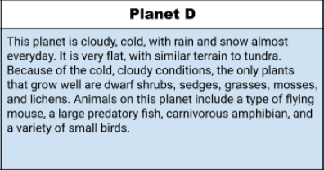
Planet D

Slide 9
The layer of skin
bamboo
Rainwater and the grass
It flys
Two eyes centered but different sizes
The wings have spikes
Going to live in a dwarf shrub and make it there home

Slide 10
wings with spikes protects them against predators
Vangs helps eat food
Ears to hear everything

Slide 11
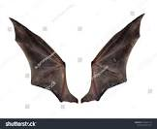
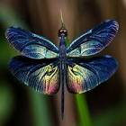
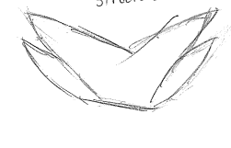
Butterfly bat dragonfly hugglemonster

Slide 12
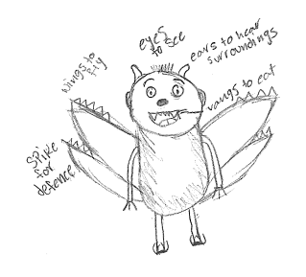
SKETCH OF SPECIES MODEL

Slide 13
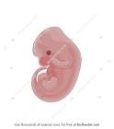
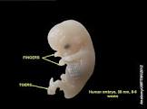
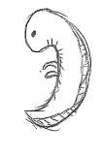
Mouse cow dog hugglemonster

Slide 14
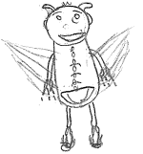

Slide 15
Traits
embryological development
evolutionary descent
environmental
Natural selection
Less

Slide 16
My species is able to survive because of the adaptations. Some adaptations are its wings to be able to fly and get around and fangs so it can eat the bamboo.some of they traits are the spikes on the wings.the homologous structures are the wings. The environment also helps my species to survive because the food is a type of grass so he can eat and it rains most of the time so it's never dehydrated.

