Slide 1
Click here for the
project check in form
Click here for the
Grading Rubric
© 2022 Williams Hands On Science

Slide 8
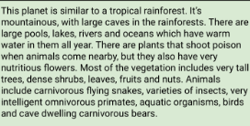
B

Slide 9
Has light fur and cool off in the pools
Fruits, Nuts, Plants
It will have a long beak able to get food and water
fly/walk
2 cm above the beak, has night vision
Runs super fast, and it can fly away
Shelter can be at the very top of the tall trees

Slide 10
Long neck
Able to reach high trees and other high things
Beak
Can get the food easily and water
Fly away easy from the predators and has long legs so it can run fast away from predators
Big wings/ long legs

Slide 11
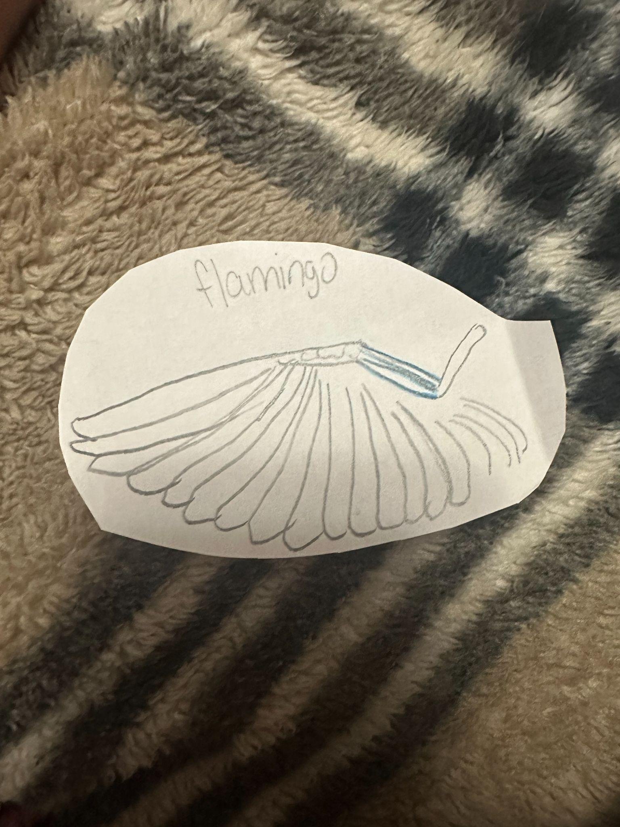
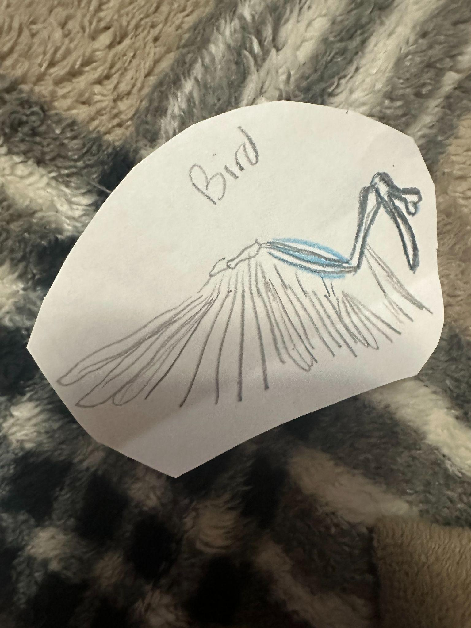
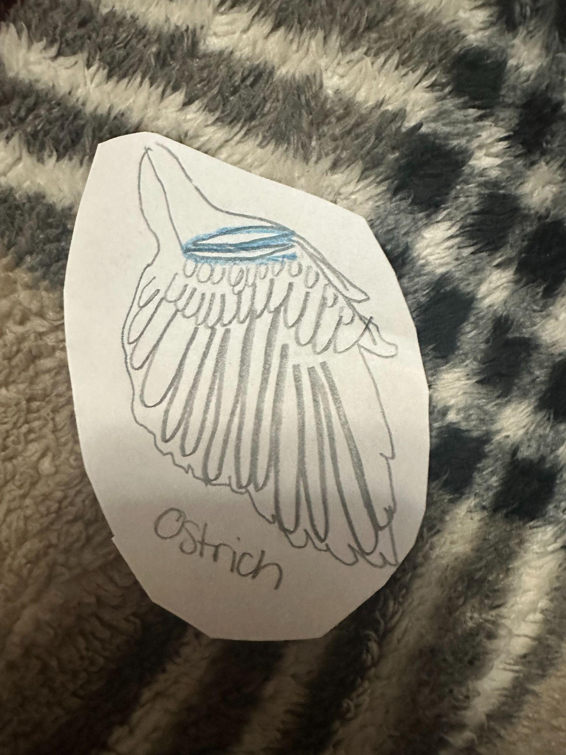
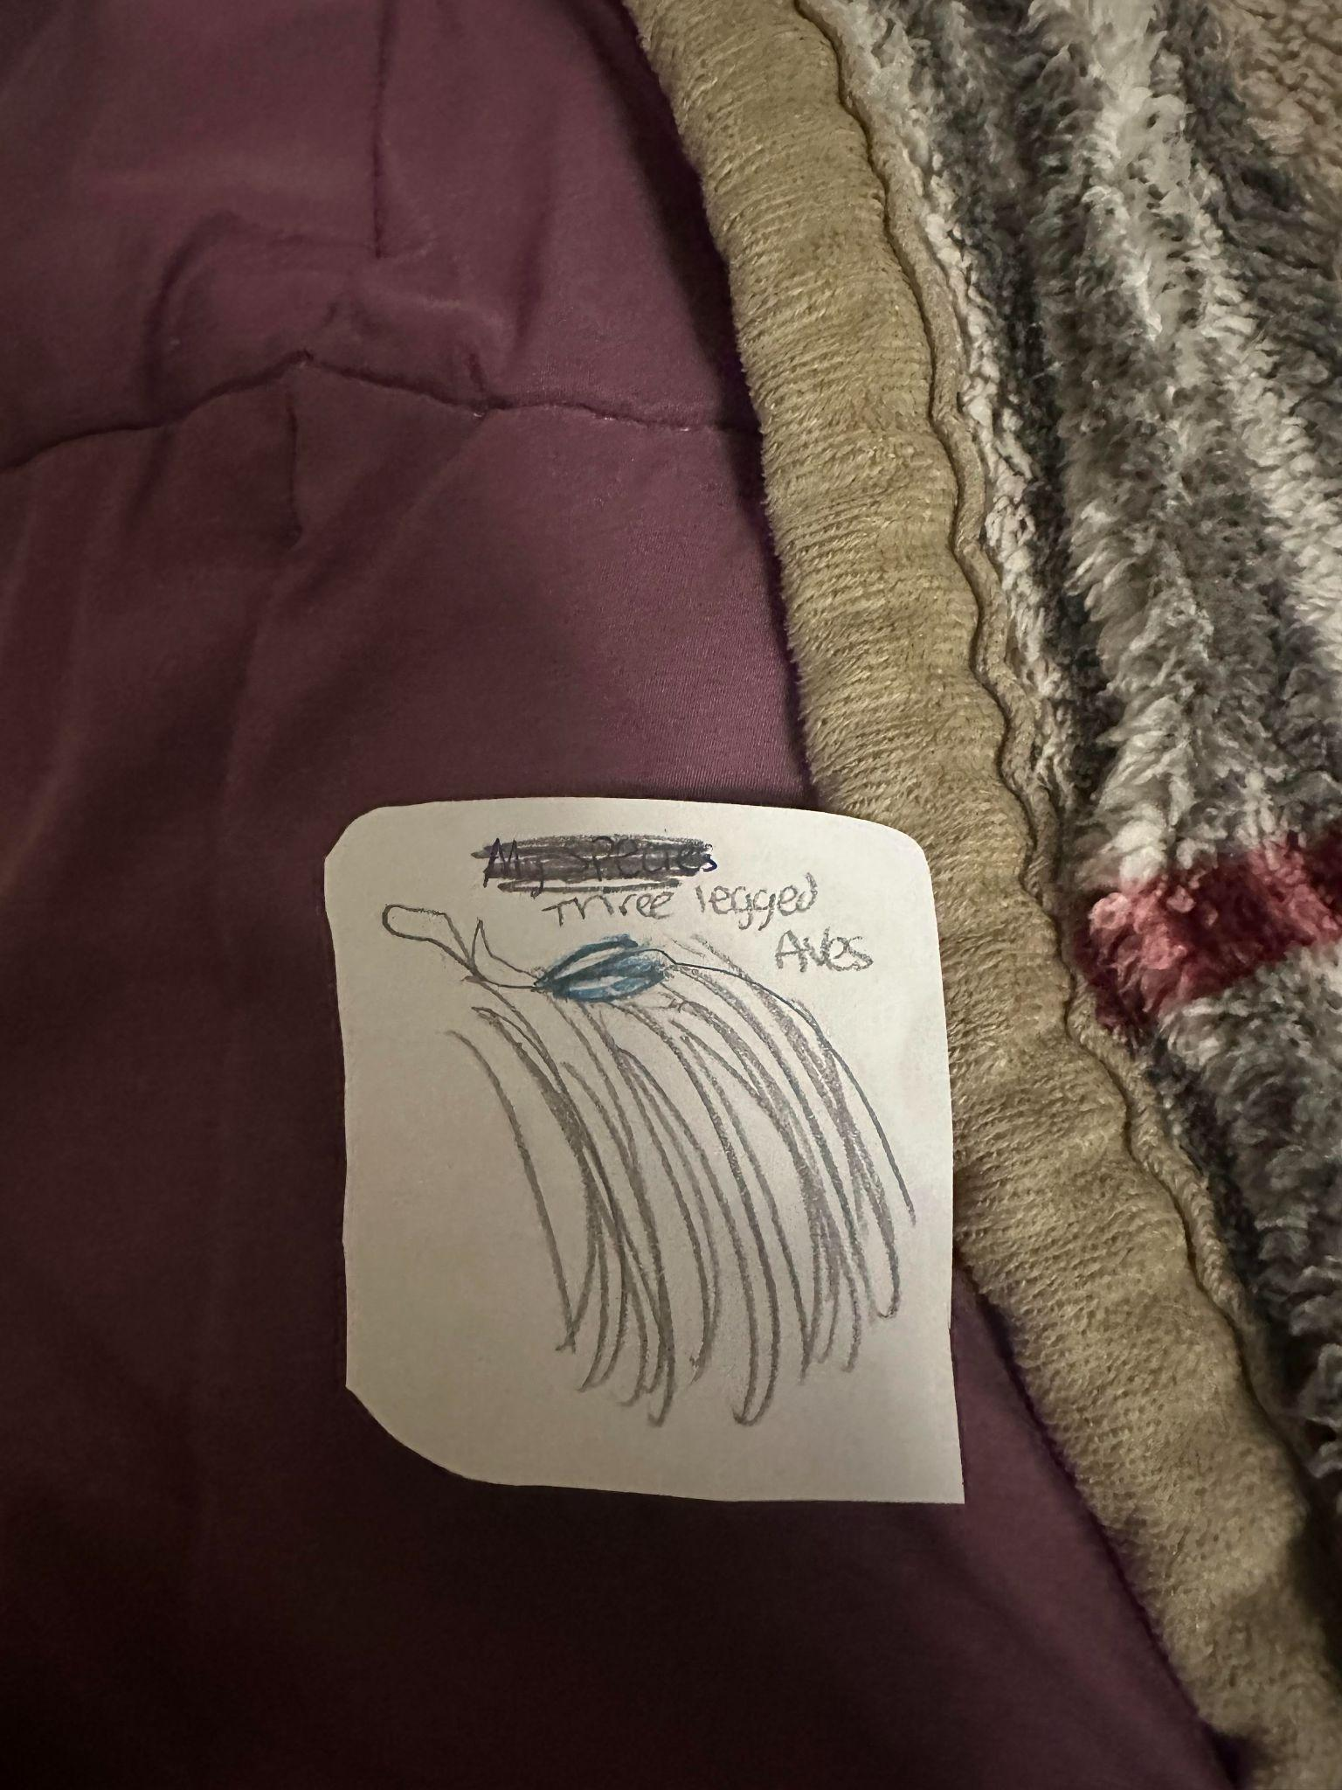

Slide 12
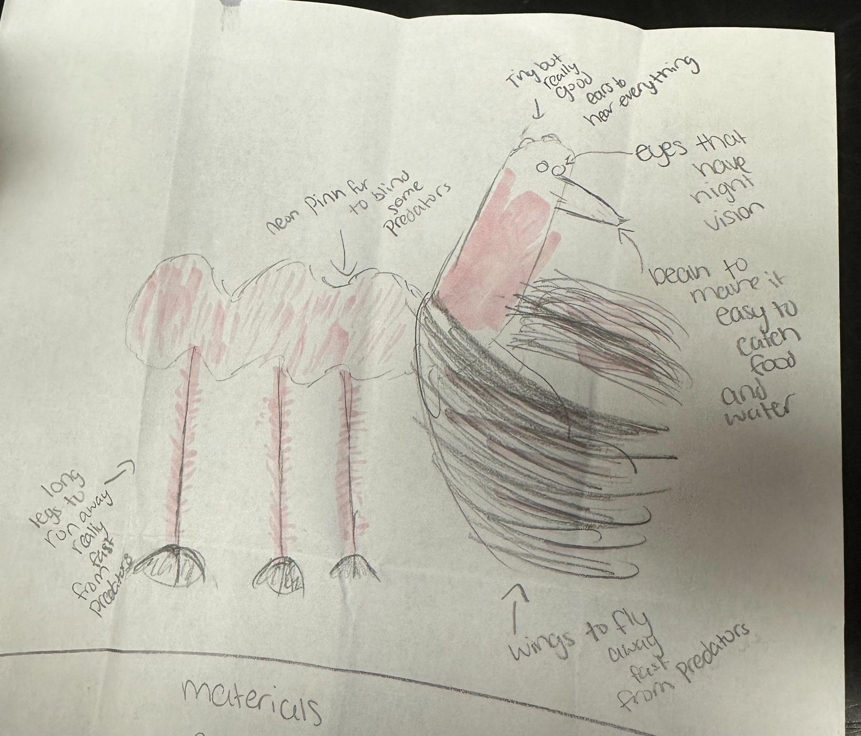
SKETCH OF SPECIES MODEL

Slide 13
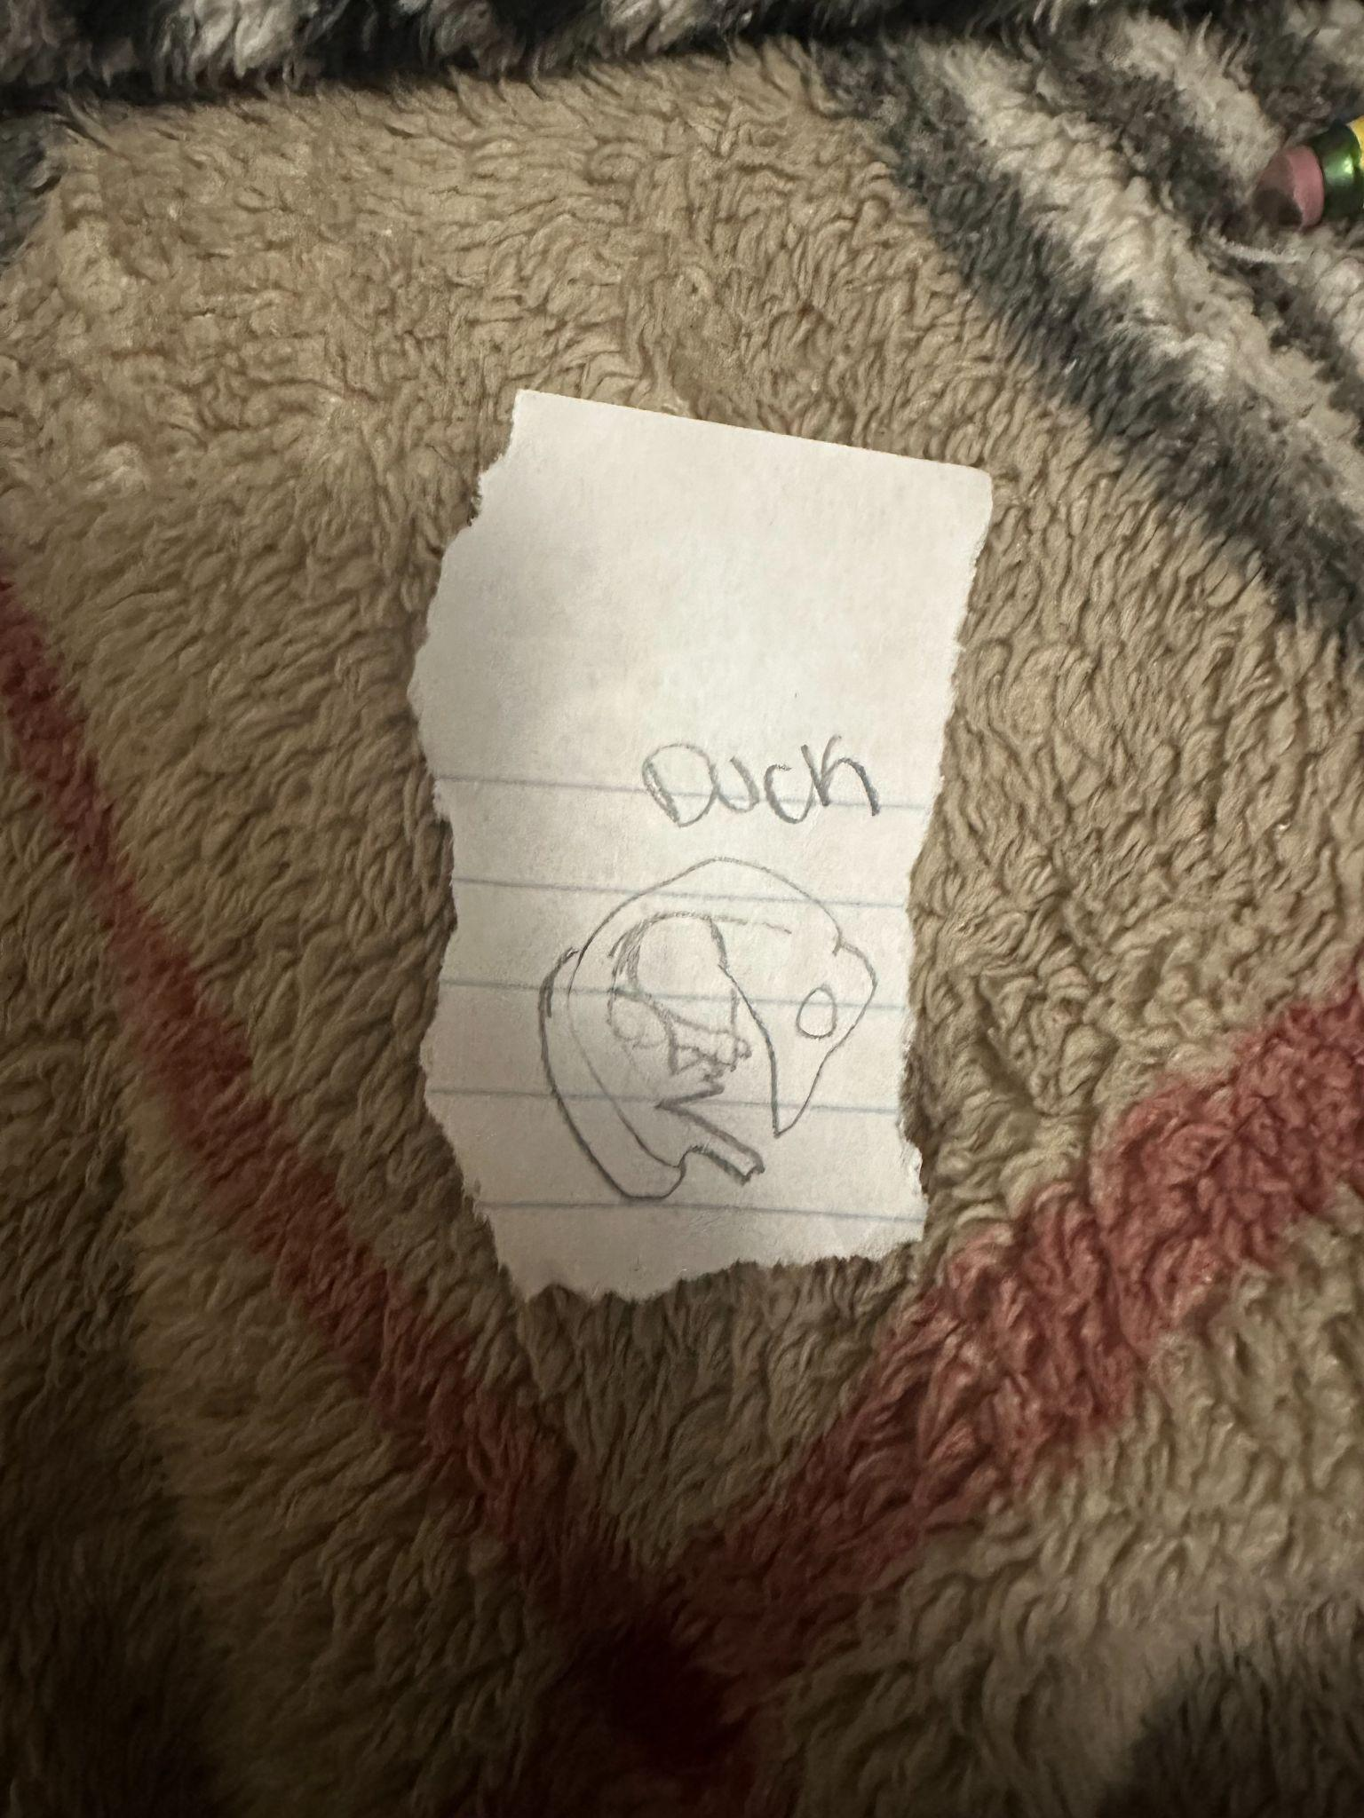
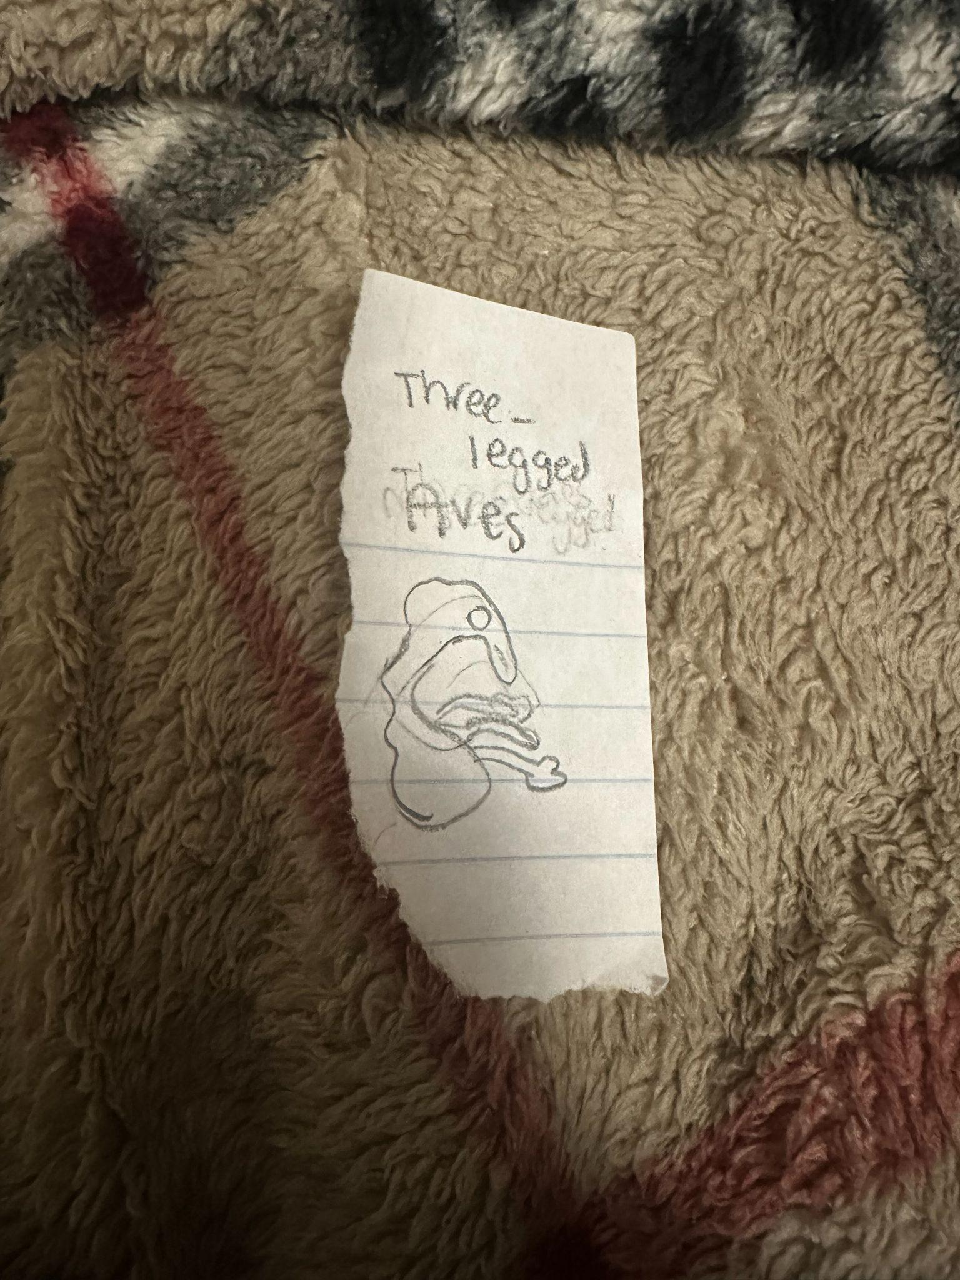
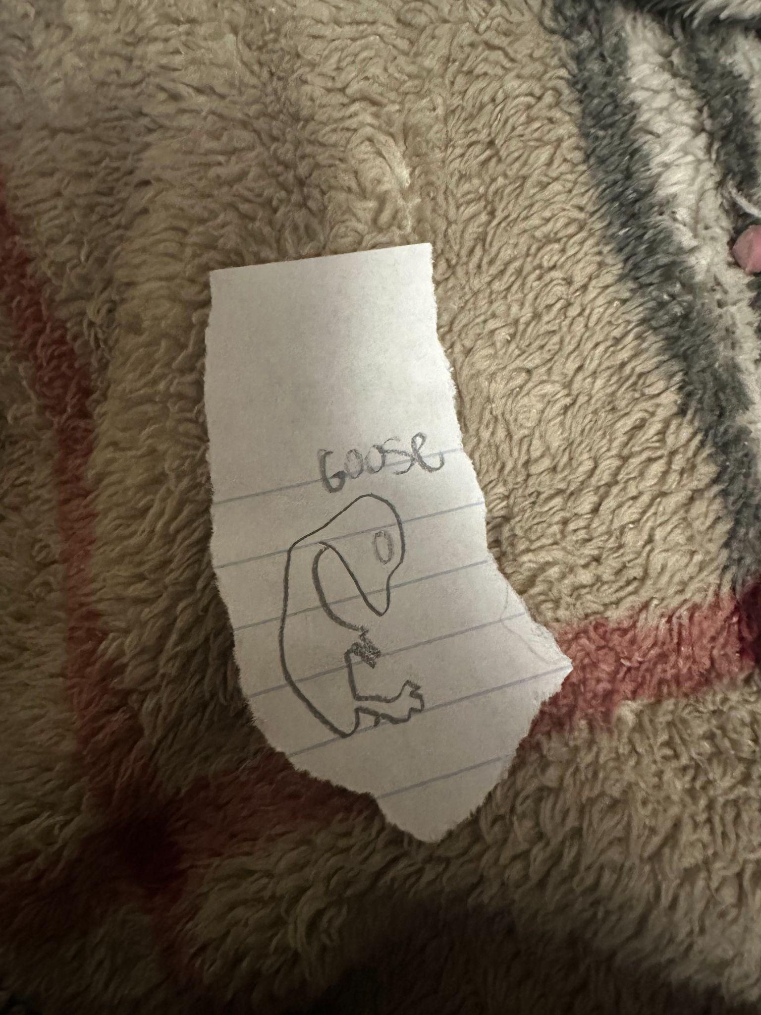

Slide 14
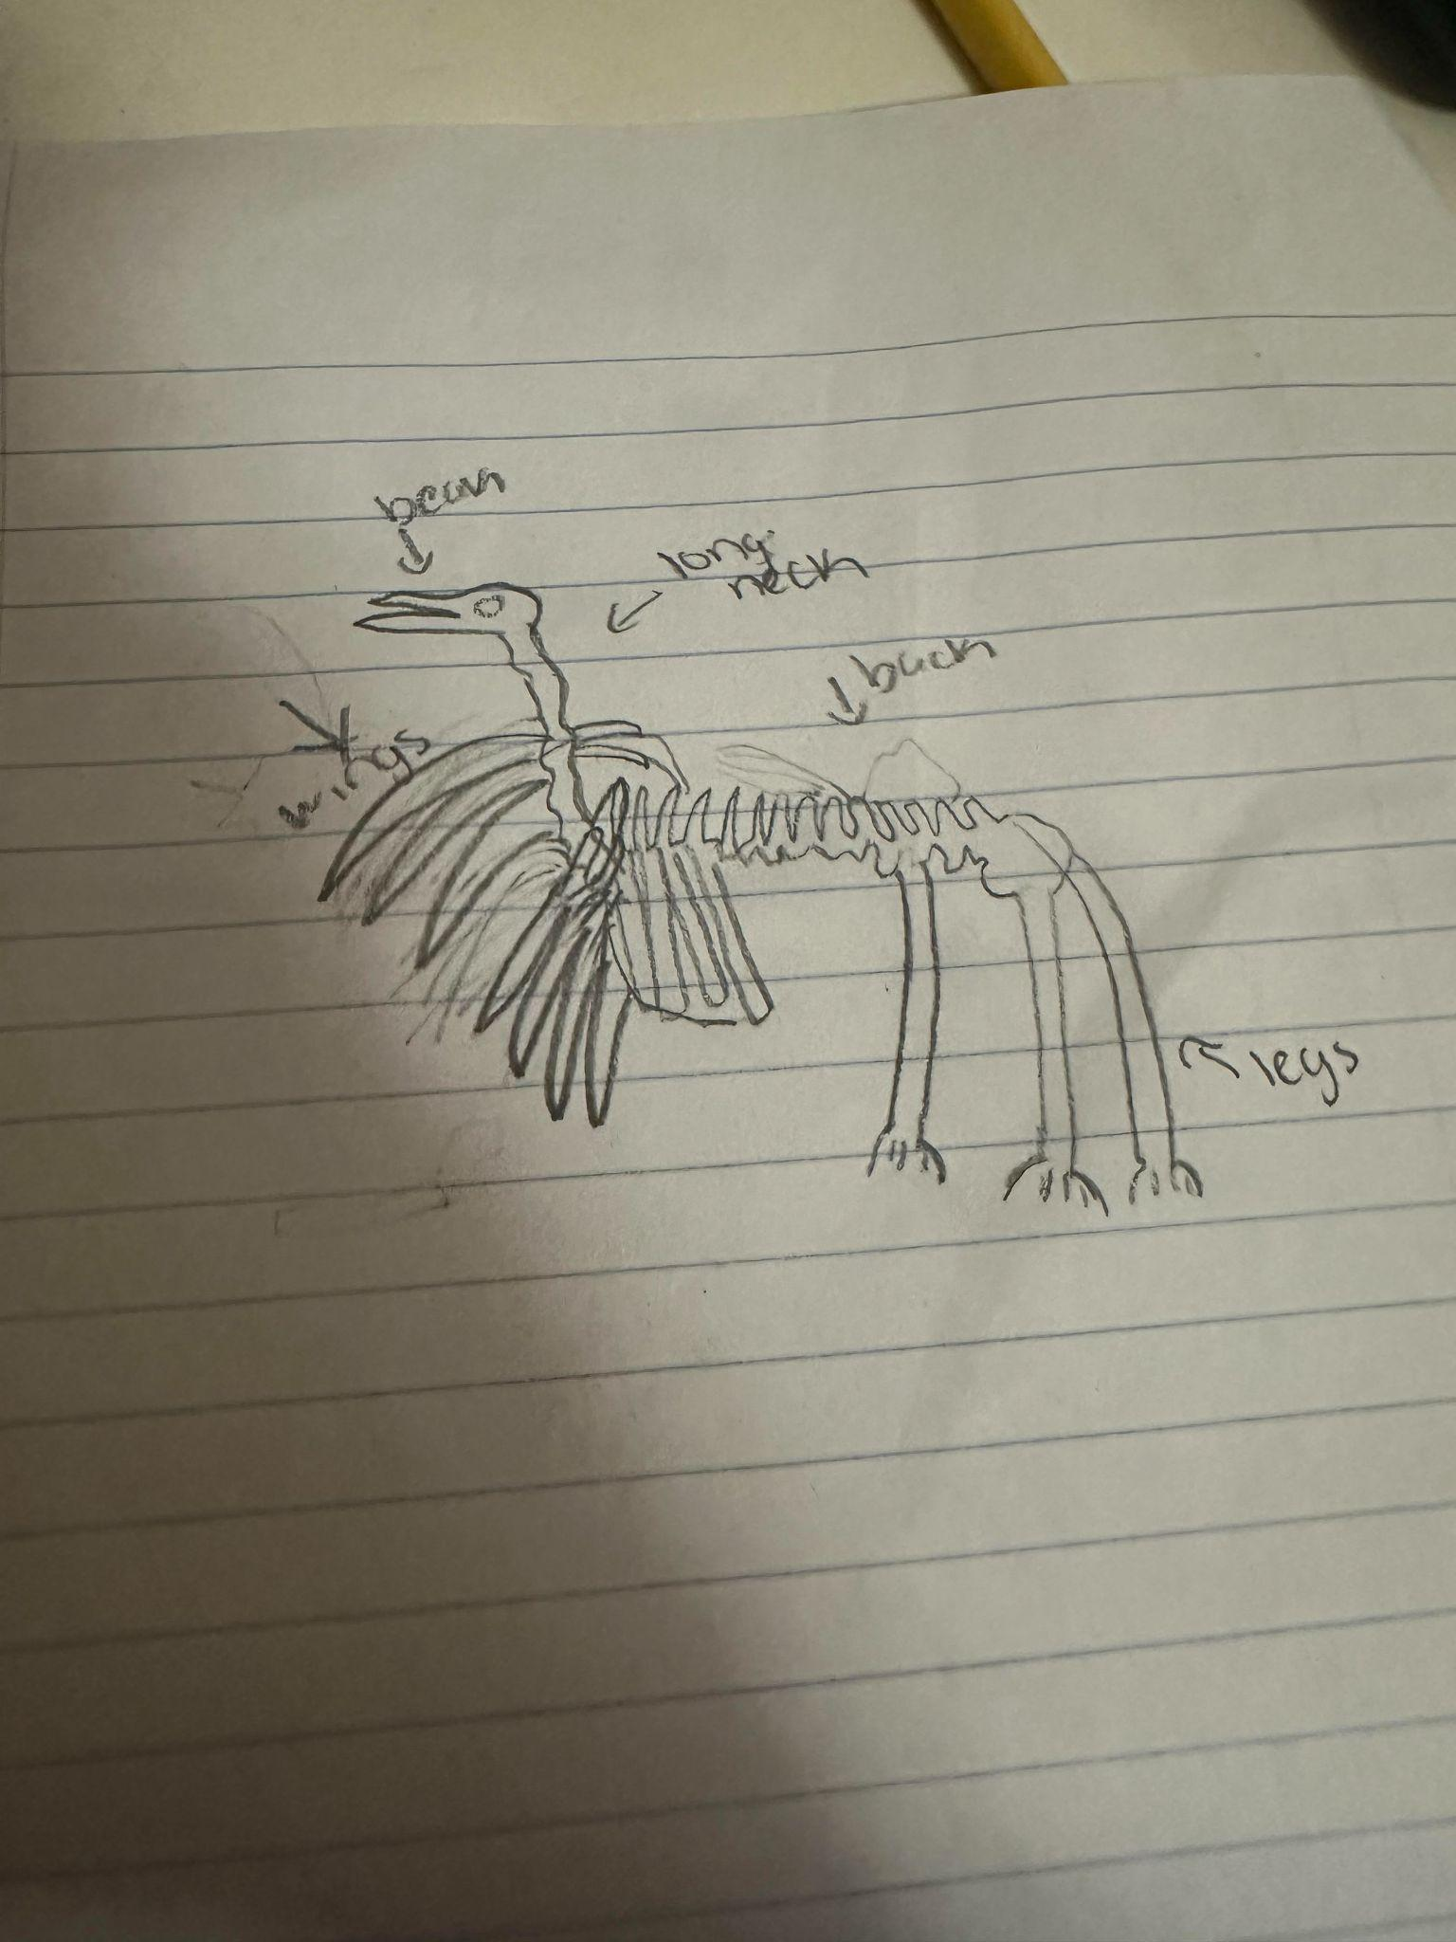

Slide 15
evolutionary descent
embryological development
Natural selection
environmental
Traits
Less

Slide 16
The Three-Legged Ave lives in a more tropical area with lakes, pools, oceans, and tropical rain forest. It has very long legs to run fast from predators and wings so it can fly away from predators. It has night vision so it can see in the dark and watch for predators.
The long beak allows it to catch food (nuts, fruits, and plants) and water. It’s embryology is like a goose, duck, and seabird. It has some of the same bone structures as a flamingo, ostrich, and just a normal bird.
To stay warmer it has light fur since typically it is warmer. To keep cool it just has the pools and other water. The Three - Legged Ave has a nest at the very top of the very tall trees so it can protect its babies from the ground animals.
Overall this creature has some very fascinating features that can help it in many different ways.

