Slide 1
Click here for the
project check in form
Click here for the
Grading Rubric
© 2022 Williams Hands On Science

Slide 8
Planet B
This planet is similar to a tropical forest. It’s mountainous, with large caves in the rainforest. There are large pools, lakes, rivers and oceans which have warm water in them all year. There are plants that shoot poison when animals come nearby, but they also have very nutritious flowers. Most of the vegetation includes very tall trees, dense shrubs, leaves, fruits and nuts. Animals include carnivorous flying snakes, varieties of insects, very intelligent omnivorous primates, aquatic organisms, birds and cave dwelling carnivorous bears.

Slide 9
It will stay warm by going into the water, and cool by going in caves.
Insects, aquatic organisms, and birds.
It has a long tongue like a frog, and very wide jaws like a snake.
It walks and can swim.
It has two eyes on the side of its head.
It will blend in with the shrubs or water.
It will either burrow into the earth beneath the water or find a suitable cave to live in.

Slide 10
It can hunt and hide in the water forever.
Helps to blend in with the environment. Changes colors like a chameleon.
To cling to cave walls and climb trees.

Slide 11
Flython
Beetle
Bird
FIsh Frog

Slide 12
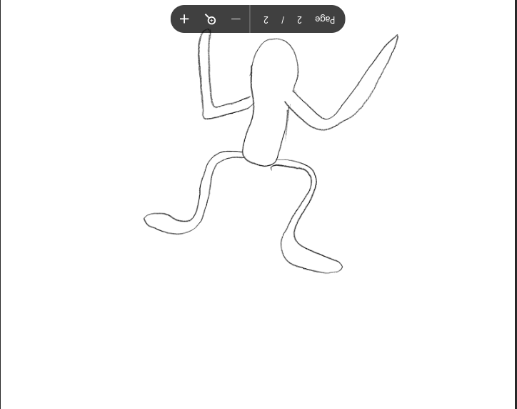
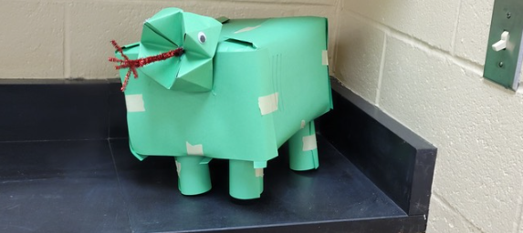
SKETCH OF SPECIES MODEL

Slide 13
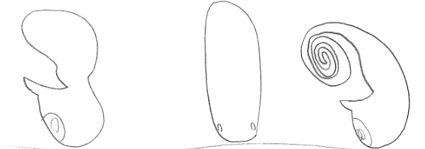
Eyes
Eyes
Eyes
Eyes
Bird
Beetle
Flython
Fish Frog

Slide 15
evolutionary descent
embryological development
Natural selection
environmental
Traits
Less

Slide 16
The Fish Frog survives in its environment by blending in with the shrubbery trees, and water, while also climbing trees. It hunts its food by sticking out its long tongue and opening its wide jaws to swallow the prey whole. Its greatest threat is the Flython, it swoops down and swallows the frog whole. It overcomes that threat by hiding in the water, or trees and camouflaging the ways chameleons do.

