Slide 1
Click here for the
project check in form
Click here for the
Grading Rubric
© 2022 Williams Hands On Science

Slide 8
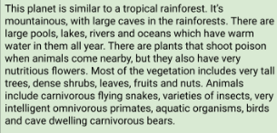
Planet B

Slide 9
Feathers and a hat
Flying snakes
It will drink the water from the lake and flies after its food
Walk, swim, fly
Two eyes in the front of the head and one on the back of its head
Swims and flies away, uses its lazer eyes, and shields itself with its bill
It will hide its young inside its hollow body and nests in clouds

Slide 10
Break away tail
If a predator bites its tail it can run away
Lazer eyes
Damages its predator
Shield Bill
Protects itself from the poisonous spray of the plants

Slide 11
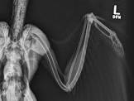
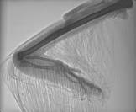
Duck
Ostrich
Gator-Duck
Chicken

Slide 12
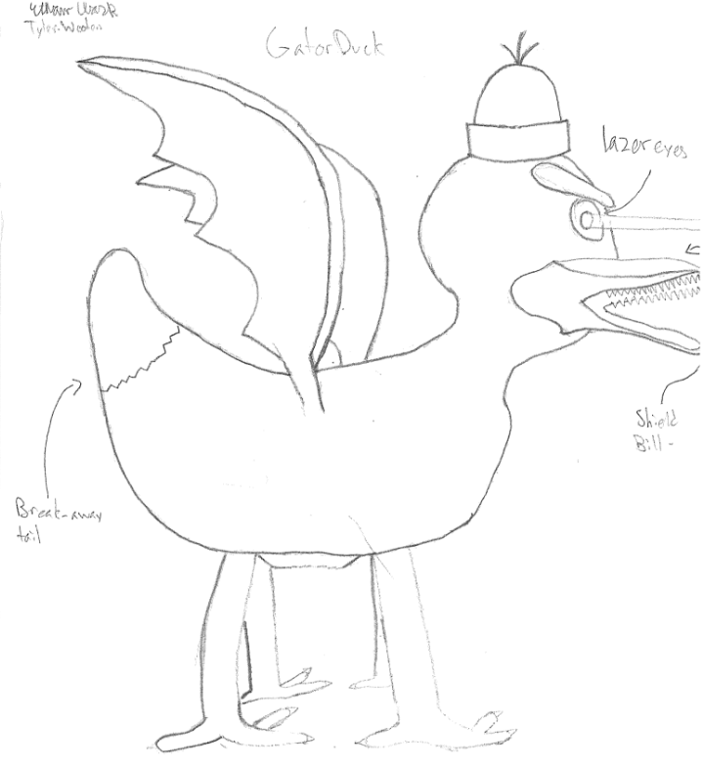
SKETCH OF SPECIES MODEL

Slide 13
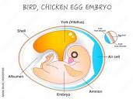
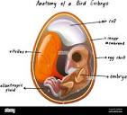
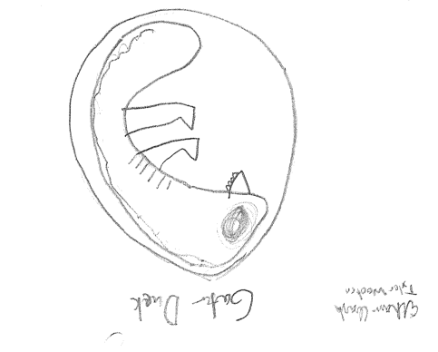
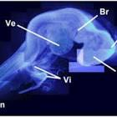
Duck
Gator-Duck
Chicken
Ostrich

Slide 14
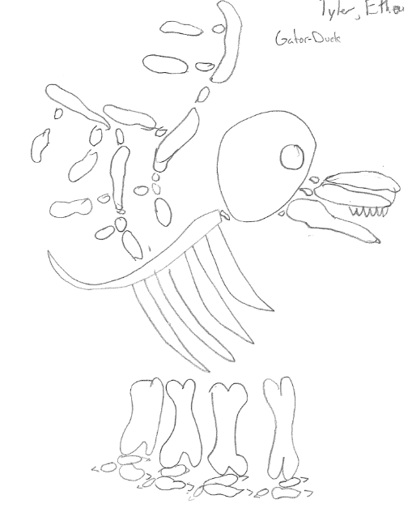

Slide 15
evolutionary descent
embryological development
Natural selection
environmental
Traits
Less

Slide 16
This species is an evolved version of earth ducks that has evolved to have it’s tail detach so it can get away if a predator bites it. It also has laser eyes to attack its prey and a protective bill that acts like a shield from the poison sprays of the plants. They deviated from the traditional ducks that tend to stick together, and now follow each other in a horizontal line instead of a vertical line. They live on clouds and when predators attack them, their young hide inside its hollow body.

