Slide 1
Click here for the
project check in form
Click here for the
Grading Rubric
© 2022 Williams Hands On Science

Slide 8
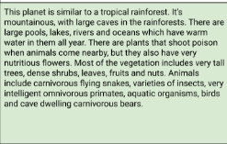

Slide 9
It skin will protect it from the cold rainy days and keep it cool for the hot days.
Bugs or snakes
It will throw webs at it's food and drink water like a normal person.
It crawls and fly s
It's eyes are on the front popping out and the tail is long and the legs are pointy
It can blend in with it's surrounding
Thye will create an underground or tree nest

Slide 10
Tail
Helps fight off prey and can grab them with its tail
Eyes
Helps it see far away and close up
Wings
Help it fly a shoots out web to catch prey

Slide 11
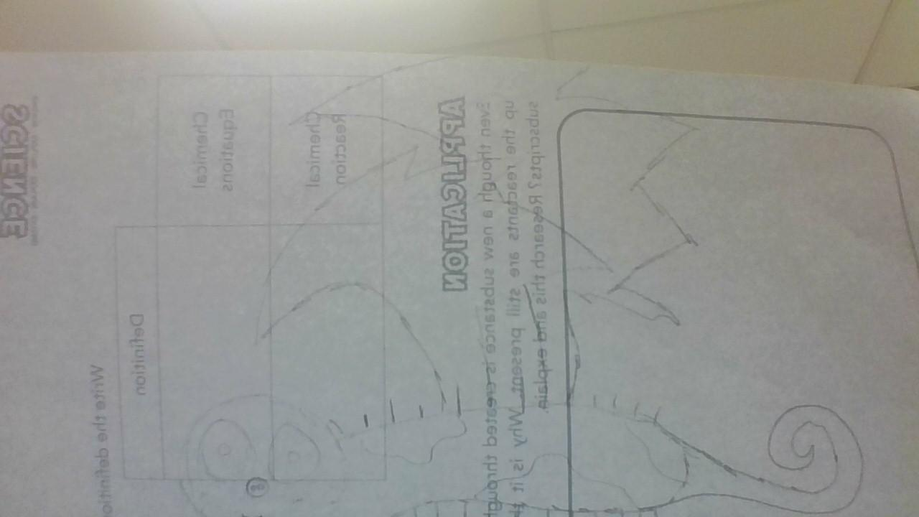
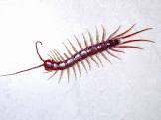
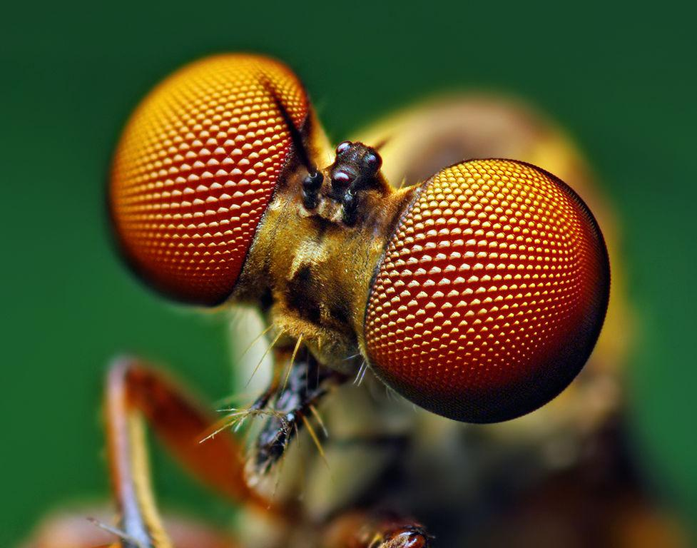
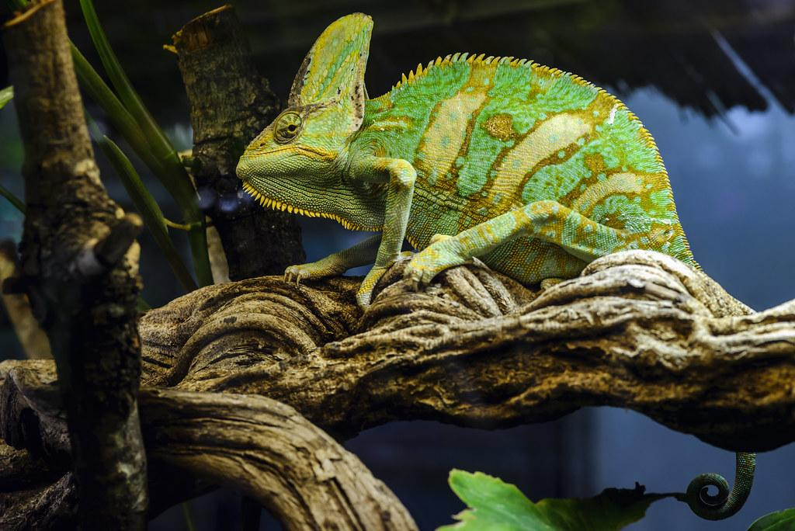
The Flymeleon
The Flymeleon
Chameleon
Centipede
Chameleon
Fly

Slide 12
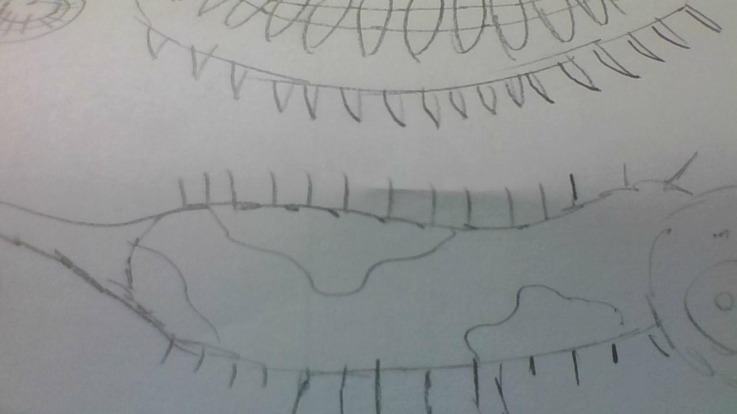
SKETCH OF SPECIES MODEL

Slide 13
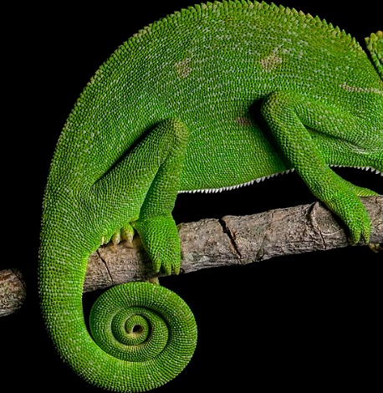
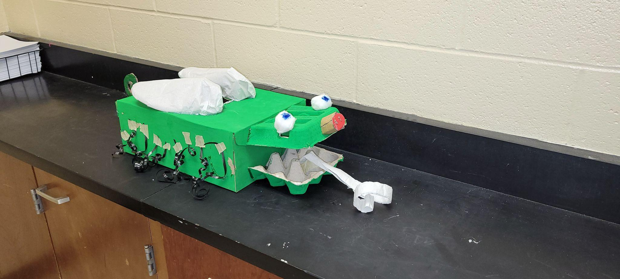
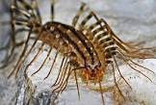

Slide 14
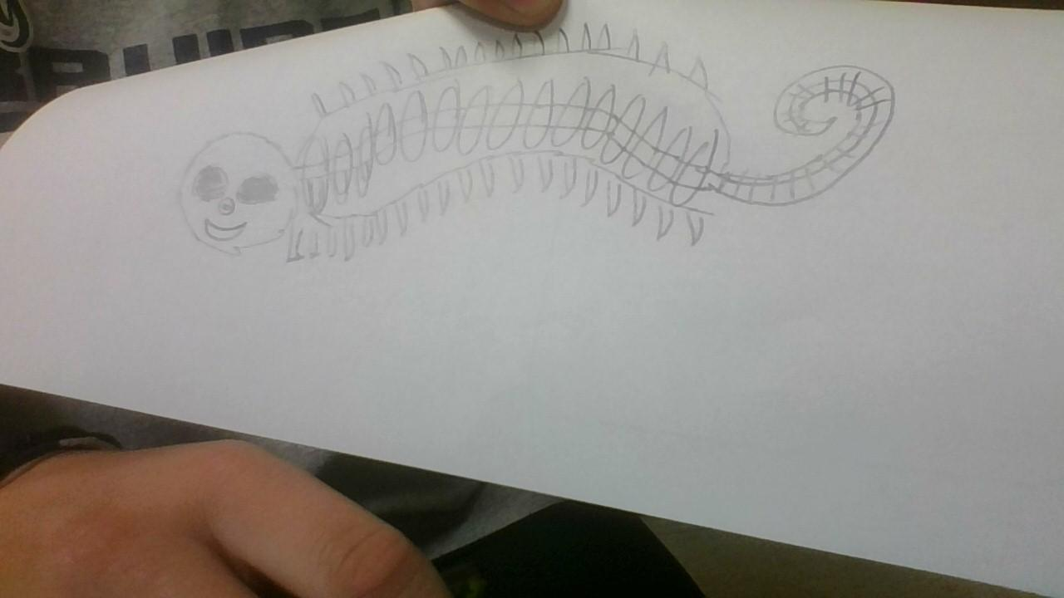

Slide 15
Traits
embryological development
Natural selection
environmental
evolutionary descent
Less

Slide 16
The Flymeleon can survive with its wings tail and amazing skin that can blend in. it can fly up from danger and create a nest for their babies and it can also make one in the ground so that it can blend in. The Flymeleon can catch its prey by shooting out webs to catch food or by using its tail to kill. The interesting creature is capable to blend in with the areas around it so that is it's being hunted it can take cover or hide at a quick pace so it will survive.

